Slide 1


Downscaling the National Low-Carbon Strategy
for the building activities
PhD defence 24.06.2024
PhD candidate: Marin Pellan
Thesis director: Prof. Guillaume Habert (ETH Zürich)
Supervisors: Dr. Mathilde Louërat, Dr. Denise Almeida (CSTB)
Notes:
Hello everyone, physically or online, today I will present parts of my PhD thesis entitled “Downscaling the National Low Carbon Strategy for Building Activities.” This research was conducted between the Chair of Sustainable Construction at ETH Zürich and the Scientific and Technical Center for Buildings in France, under the supervision of Prof. Guillaume Habert, Dr. Mathilde Louërat, and Dr. Denise Almeida.
First of all, I would like to thank all the members of the jury for reading the manuscript and attending this presentation. I would also like to extend my gratitude to Prof. Taras for being the chair of the jury

Slide 2

Summary
Introduction & context
Research gaps, state of the art & research questions
Contribution of the thesis
Emissions accounting and carbon budgets setting
Exploratory decarbonisation pathways for residential buildings
Prospective LCA for new construction
Conclusion & discussions
Notes:
To guide you through the presentation:
First, I will introduce the context in which this research is grounded
Next, I will highlight the identified research gaps, how previous studies have addressed them and the proposed research questions of the thesis
Following that, I will focus on three key contributions of the thesis:
The development of an emission accounting and carbon budget setting methodology.
The creation of a framework for exploratory decarbonization pathways at the residential stock level.
The establishment of a method to couple a building LCA database with prospective LCA tools.
Finally, I will close the presentation with some conclusions and outlooks for future studies.

Slide 3
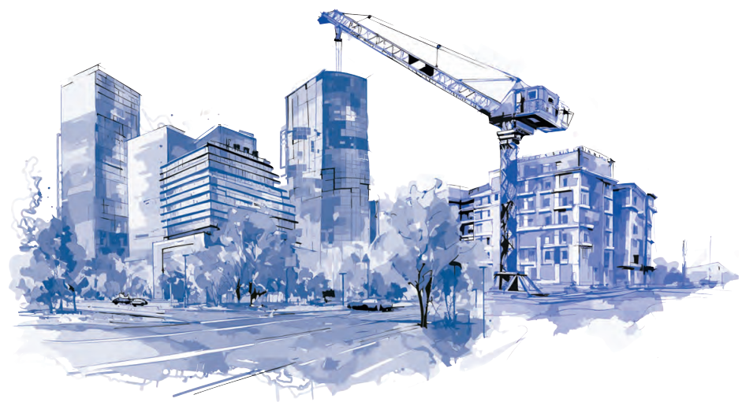
Introduction & context
Climate objectives
Buildings GHG emissions
Climate and building policies
Notes:
In this first part, I will introduce the climate objectives at global and national level, and explain why buildings play a key role in climate change mitigation

Slide 4


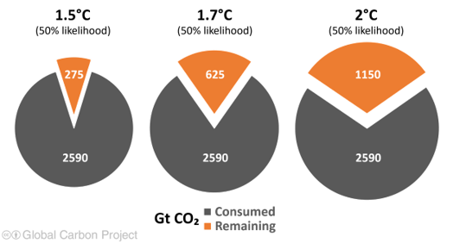
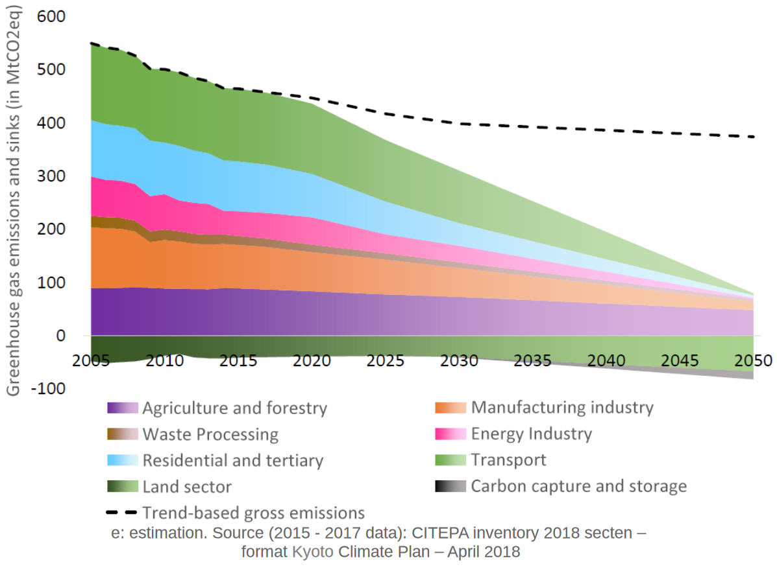
Climate objectives
Buildings GHG emissions
Climate & building policies
Introduction & context
Shrinking carbon budgets
Remaining carbon budgets
Low-Carbon National Strategy (SNBC)
Global Carbon Project (2023)
Ministry for Ecological Transition (2019)
Notes:
In 2015, the Paris Agreement set long-term goals to limit global warming to well below 2°C, and to pursue efforts to limit it to 1.5°C by the end of the century. This urgency requires peaking emissions as soon as possible and transitioning to net-zero emissions.
A key implication of these goals is that our remaining carbon budgets are limited, demanding a sharp decline in emissions across all sectors.
At the national level, the Paris Agreement translates into the Low-Carbon National Strategy (SNBC). This strategy allocates sectoral carbon budgets among different macro-economic sectors, aiming for net-zero emissions by 2050.

Slide 5







Climate objectives
Buildings GHG emissions
Climate & building policies
Introduction & context
Type and magnitude of building-related GHG
Operational GHG
+
Embodied GHG
=
Life-cycle GHG
Direct
Fossil fuels, biomass, F-Gases
Indirect
Construction
materials & equipment
Electricity, district heating
*
*
28% CO₂
> 9% CO₂
*
> 37% CO₂
**
***
***
23% territorial GHG
9% footprint GHG
2.2tCO₂/cap
* UNEP (2022), Global Status Report for Buildings and Construction (energy and process-related CO₂, concrete, aluminium, steel, bricks and glass only)
** CITEPA & Ministère de la transition écologique (2019) (using direct emission-factors)
*** SDES (2023), L’empreinte carbone de la France de 1995 à 2022 (CO₂, CH₄ and N₂O)
Notes:
So why are we talking about buildings when we study climate change mitigation?
Buildings contribute to emissions in two main ways:
- First, there are operational emissions, which come from the use of buildings. These can be further divided into direct and indirect emissions.
- Second, there are embodied emissions, which are the emissions from the life-cycle of construction materials and equipment.
Globally, the life-cycle emissions of building activities account for around 40% of global CO2 emissions from energy and processes. This makes them a major concern for meeting our climate goals. In France, operational emissions make up 23% of territorial emissions in 2019. When considering life-cycle emissions, buildings are the second biggest contributor to the carbon footprint of French citizens, behind transport.

Slide 6



Climate objectives
Buildings GHG emissions
Climate & building policies
Introduction & context
Building and climate legislation at EU and French levels
Energy Performance on Buildings Directive (EPBD)
Renovation Wave
Whole-Life Carbon limit values in some EU countries (Denmark, Netherlands)
Low-energy consumption residential building stock by 2050
In 2050, direct operational GHGE ~5MtCO₂eq, fully decarbonise electricity grid
New building Environmental Regulation (RE2020)
Notes:
To mitigate building life-cycle emissions, there are several pieces of legislation at different levels:
-At the EU level, we have the revised EPBD, which focuses mainly on reducing operational emissions. Additionally, the Renovation Wave initiative aims to foster the renovation of existing buildings. Some countries also have laws targeting life-cycle emissions of buildings, with specific limit values, although very few do.
-In France, the residential building stock must achieve low-energy consumption levels by 2050, with sharply reduced operational emissions. The new building environmental regulation is innovative as it addresses both operational and embodied emissions by setting declining and mandatory limit values to be met by 2031, although it only applies to new construction.

Slide 7
Research gaps, state of the art & research questions
Research gaps & state of the art
Emissions accounting challenges for buildings
Complexity of modelling buildings at scale
Linking top-down and bottom-up visions
Research questions
Notes:
Now What are the identified research gaps related to these topics, how has research addressed them, and what have we learned from this to formulate our research questions?

Slide 8
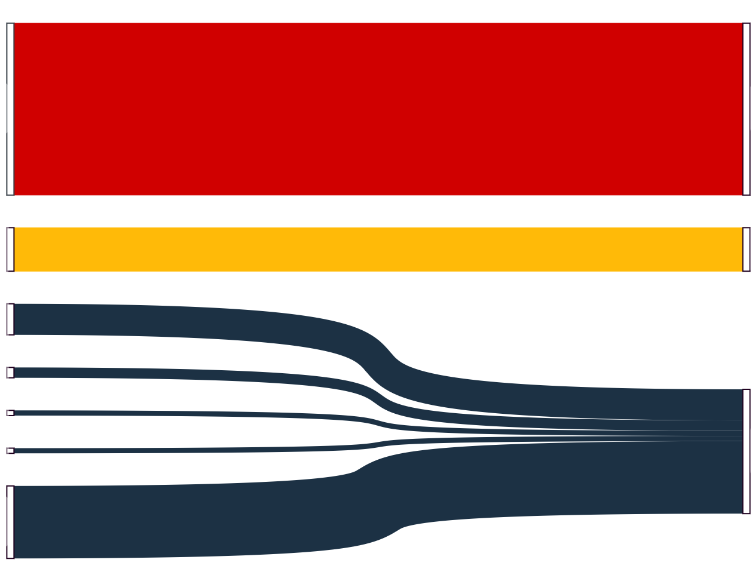
Research gaps, state of the art & research questions
Emissions accounting challenges for buildings
Research gaps
Research questions
National
GHG inventory*
Buildings
GHG
Building
LCA**
Building
Lack of holistic view in
decarbonisation pathways
and sectoral carbon budgets
(Giesekam et al. 2018)
Direct
operational
emissions
B6-B7
Indirect
operational
emissions
Energy
B6-B7
Industry
Transport
Waste
A1-A5
B1-B5
C1-C4
Agriculture
Land-use
Embodied
emissions
Imported
Emissions
* IPCC guidelines (2006)
** EN-15978 (2012)
Notes:
One major gap is the disparity in systems for accounting for emissions. In national emission inventories reported to the United Nations, 'buildings' only refer to direct operational emissions, or B6-B7 phases in the building LCA system, which is used in building legislation.
This overlooks other emissions types, which are included in other sectors like industry or transport, as well as imported emissions which are absent from national inventories.
This lack of comprehensive accounting system affects decarbonisation pathways and sectoral carbon budgets, as they typically rely on the inventory format. As Giesekam pointed out, this leaves building stakeholders without a holistic view for effective mitigation strategies. It also creates a gap between climate policies, such as the SNBC, which rely on the inventory format, and sectoral policies, such as the building environmental regulation, which increasingly rely on life-cycle thinking.

Slide 9





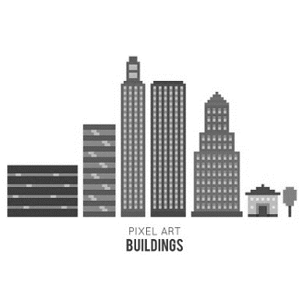


Research gaps, state of the art & research questions
Complexity of modelling buildings at scale
Research gaps
Research questions
Hybrid life-cycle assessment
Input-Output Analysis
Data granularity
Building stock modelling
Modelling challenges and complexity,
Policy relevance
Emissions accounting
Life-cycle assessment
Prospective studies
MICRO SCALE
(individual buildings)
MESO SCALE
(neighbourhood, city)
MACRO SCALE
(country, continent)
Uncertainties
TIME
SPACE
Notes:
Now, let's explore how we model building life-cycle emissions and the methods we use.
This can be done at various levels, from micro to macro scale. For climate objectives, macro scale results are important. However, modeling at this scale presents complex challenges, such as data scarcity and methodological issues, including determining which buildings to model for relevant analysis.
Furthermore, adding a time dimension for future projections of building emissions increases uncertainties.
To address these challenges, several methods were studied in this thesis, shown in yellow, and extensively described in the manuscript. Some focus on a single scale, while others, like life-cycle assessment and building stock modeling, bridge different scales and are increasingly used at macro scale for climate policies. Recently, there has also been a rise in prospective studies at both international and national levels, which can help test different hypotheses about the future state of buildings and related sectors like the energy and industry sectors.

Slide 10












Research gaps, state of the art & research questions
Linking top-down and bottom-up visions
Research gaps
Research questions
Carbon budgets
Bottom-up benchmarks
Decarbonisation pathways
World
Country
2050
Economic
sectors
Zhang et al. 2024
Alaux et al. 2023
Top-down
Bottom-up
2035
Li et al. 2023
(UK, renovation)
Cross-sectoral
activities
2020
Building(s)
Röck et al. 2023 (EU)
Mouton et al. 2024 (Belgium)
Priore et al. 2023 (Switzerland)
Horup et al. 2023 (Denmark)
Building stock database
Building LCA database
Notes:
To reach our climate objectives while understanding the current state and possible evolution of buildings, two types of modeling are often used: top-down and bottom-up.
The first one helps downscale high-level objectives to lower levels, like countries, economic sectors or even individual buildings. This often requires to use effort-sharing principles which are extensively described in the literature. What is often critical in terms of methodology is to downscale from country to cross-sectoral activities, mainly because of the accounting challenges presented earlier.
The second one provides detailed data on the current state of buildings and practical implications of decarbonization strategies. It also allows to study interactions between different sectors.
Recently, several European studies have used these modeling types (as shown in blue). In addition, data availability from building stock databases and building LCA databases has increased, improving the relevance and possibility of bottom-up analysis.
However, the link between these modeling types, especially for the entire building stock and the different stock-level activities (new construction, renovation, demolition), remains underexplored. The goal would be to answer the question of how to better align actions with climate goals, and use detailed bottom-up data to study the conditions under which we can meet them.

Slide 11

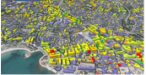
Research gaps, state of the art & research questions
Research questions
Research gaps
Research questions
How to develop carbon budgets for the building activities
and model exploratory decarbonisation scenarios by 2050 using life cycle thinking ?
Research question 1 (RQ1) :
Emissions accounting and carbon budgets setting
How to highlight the different scopes of emissions (energy carriers and supply-chain emissions) and expand/complement existing sectoral climate policies?
BUILDING ACTIVITIES
Research question 2 (RQ2) :
Exploratory
decarbonisation
pathways
How can we assess the alignment of future residential emissions with predefined carbon budgets?
RESIDENTIAL BUILDINGS
Research question 3 (RQ3) :
Prospective
LCA
How do different building typologies perform in terms of embodied emissions now and in the future decades, when considering the decarbonisation of supply sectors?
NEW RESIDENTIAL BUILDINGS
Notes:
This exploration of the research gaps lead us to the research questions that we have identified in this thesis. The main question of this thesis is: 'How to develop carbon budgets for the building activities and model exploratory decarbonization scenarios by 2050 using life cycle thinking?'
To answer this, three sub-questions were tackled:
Relative to emission accounting and carbon budget methodology: How can we highlight the different scopes of emissions and expand or complement existing sectoral climate policies? In this first part, we cover the entire building activities.
Concerning decarbonization pathways and residential dynamics: How can we assess the alignment of future residential emissions with predefined carbon budgets? In this second part, we focus on the residential building stock.
Lastly, for future embodied performance of individual buildings: How do different building typologies perform now and in the future decades, when considering the decarbonisation of supply sectors?“. In this last part, we specifically target new residential construction.

Slide 12
01. Emissions accounting and carbon budgets setting (RQ1)
Emissions accounting results in 2019
Carbon budgets results by 2050
Operational budget
Embodied budgets
Notes:
Now let’s dive into the methodology and let’s begin with outlining the carbon budgets set for the French building activities by 2050.

Slide 13



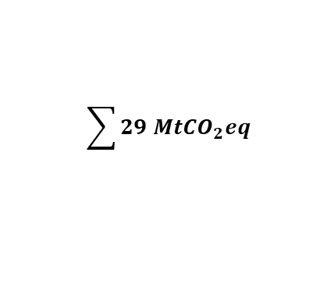
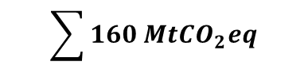
1. Emissions accounting and carbon budgets setting
Downscaled climate goals: life-cycle carbon budgets by 2050
RQ1
Direct & Indirect
Operational GHG
Embodied GHG
Scope 3 (FR)
2019
58MtCO₂eq
$$\sum{160 {MtCO}_{2}eq}$$
40%
60%
83MtCO₂eq
21MtCO₂eq
2030
49MtCO₂eq
2.4°C
Stated Policies (SP)
58MtCO₂eq
14MtCO₂eq
1.7°C
Announced Pledges (AP)
52MtCO₂eq
1.5°C
Net Zero (NZ)
44MtCO₂eq
2050
5.7MtCO₂eq
2.4°C
SP
56MtCO₂eq
0.9MtCO₂eq
1.7°C
AP
22MtCO₂eq
$$\sum{29 {MtCO}_{2}eq}$$
1.5°C
NZ
2.2MtCO₂eq
$$\sum{9 {MtCO}_{2}eq}$$
* Results were integrated in the French building activities decarbonisation roadmap (2023)
Notes:
Because of time constraints, I will not go into the detail of the methodology here, which is fully described in the manuscript. It is just important to note that operational emissions are calculated based on the national energy balance and life-cycle emission factors, while embodied emissions are calculated using a multi-regional input-output database called Exiobase
I will now go directly to the results, which are the emissions and carbon budgets results for the different scopes of emissions. In 2019, operational emissions dominate with 65% of the total life-cycle emissions, while 60% of embodied emissions come from abroad. To translate these results into 2050 goals, operational emissions are projected using the SNBC buildings and energy pathways which assume a rapid and steep decrease. Embodied emissions are projected using three scenarios proposed by the International Energy Agency, which lead to different temperature outcomes by the end of the century, through the decarbonisation of the different sectors involved in the building activities supply chains.
In 2050, under the combined SNBC and Announced Pledges Scenario, which assumes all climate policies by countries are fulfilled, life-cycle emissions of French buildings should be below 30MtCO2eq. Under the Net Zero Scenario, emissions are projected to be under 10 MtCO2eq.
It should be noted that the SNBC does not transparently display the effort-sharing principle used for downscaling at the national level, and its sectoral pathways are based on multiple models that are not fully integrated. In the IEA scenarios, the pathways are based on techno-economic models that integrate the decarbonisation potential and costs of the different sectors.

Slide 14
02. Exploratory decarbonisation pathways for residential buildings (RQ2)
Methodology
Framework
Designing scenarios
Results
GHG in 2050
Pathways
Cumulative GHG
Notes:
Now that we have our carbon budgets objectives for the building activities, how can we assess the alignment and compatibility of the residential dynamics and its associated emissions?

Slide 15





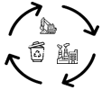





2. Exploratory decarbonisation pathways for residential buildings
Modelling framework
RQ2
Methodology
Results
Stock dynamics
Supply-side
How many additional buildings
should we expect?
How do the current
residential stock will evolve?
How will buildings be supplied in energy and materials?
Electricity
Gas, district network
Embodied performance
Notes:
So for that we have created a framework to study future possible emission levels starting from the current residential stock?
We can break this down into three sub-questions for which we have integrated and designed scenarios and methods.
The first one is : How many additional buildings will we have?
For that we have calculated the yearly demand based on expected population growth, needs and demolition surfaces
The second one is: How will the existing building stock evolve through renovation and demolition?
Here, we have relied on a building stock database and existing energy simulation, which included a potential state after renovation. We have also integrated differences renovation paces to analyze the effect of the distribution of the efforts over the next decades.
Finally the third one is: How will buildings be supplied in energy and materials?
Here, we have first integrated different national scenarios for three energy carriers, namely electricity, gas and district network. And we have assumed different levels of embodied performance, in alignment with the environmental regulation.
The first two questions relate to the dynamics of the residential stock while the last one is more focused on the evolution of the supply sectors.

Slide 16
2. Exploratory decarbonisation pathways for residential buildings
Designing scenarios
RQ2
Methodology
Results
Stock dynamics scenarios
Supply-side scenarios
Operational GHG
scenarios
Business-
As-Usual
(BAU)
scenario
High renovation
Constant
High
Construction
High
Demolition
Middle of the road
(180 000 /yr*)
(150 000/yr)
SNBC
Middle renovation
(22% of 2020 dwellings**,
250 000/yr*)
Embodied GHG
scenarios
+ pace scenarios
High renovation
Ambitious
(AMB)
scenario
Medium
Construction
Medium
Demolition
RE2020
(67% of 2020 dwellings**,
750 000/yr*)
(110 000/yr*)
(90 000/yr)
RE2020++
Middle renovation
Fossil fuels targeting
High GHG → Low GHG
Targeting
variants
* Average number of dwellings 2020-2050
Energy performance targeting
G → A
** Total number of dwellings 2020-2050
Notes:
Because there are many parameters involved in each subquestion, we can potentially build hundreds of scenarios by combining them. As a result, we have designed two main families of scenarios:
A Business-as-Usual Scenario: which continues the current trends in terms of construction and demolition
An Ambitious Scenario: which tends to avoid the demolition of existing buildings and the construction of new building.
Different renovation dynamics can then be combined to each of these scenarios. As well, thanks to the use of the building stock database, we are able to test different targeting variants, namely if we focus on renovating only based on the energy performance label or if we target the type of energy carrier used.
Different supply-side scenarios can also be combined. In particular, we have tested variants where we keep the same emission factors for all energy carriers or if we integrate the different scenarios shown previously for electricity, gas and district network. We have also tested variants where the decreasing levels of embodied performance stop in 2031, as expected in the Environmental regulation, of if the decreasing trend continues up to 2050.
The results presented after will be the combination of the red parameters for the BAU scenarios and the green parameters for the ambitious scenarios.

Slide 17
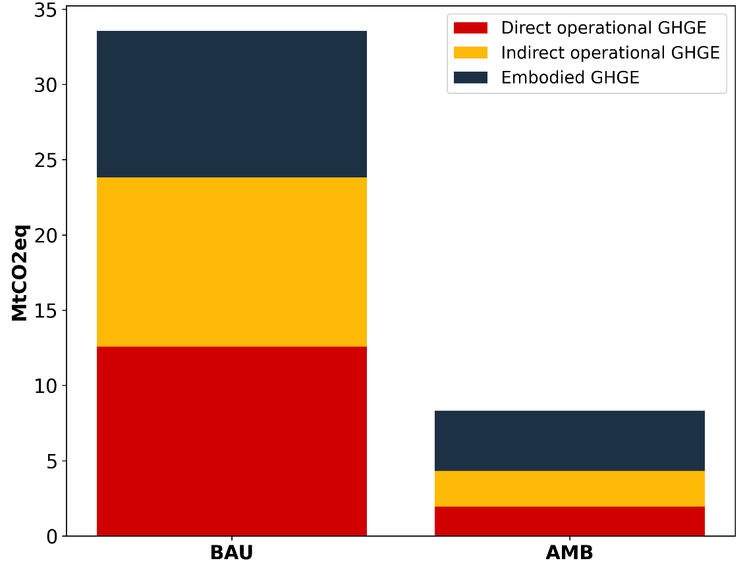
2. Exploratory decarbonisation pathways for residential buildings
2050 residential GHG in BAU and AMB
RQ2
Methodology
Results
2050 GHG
30
SNBC-Announced Pledges
(entire building activities)
SNBC-Net Zero < AMB scenario < SNBC-Announced Pledges
Ambition ⬈ → % embodied GHG ⬈ ⬈
(35% of life-cycle emissions in 2019 vs 50% in 2050 in AMB scenario)
% Indirect operational emissions ⬈ ⬈
(13% of life-cycle emissions in 2019 vs 26% in 2050 in AMB scenario)
Ambition ⬈ → % Direct operational emissions ⬊ ⬊
(51% of life-cycle emissions in 2019 vs 24% in 2050 in AMB scenario)
20
MtCO₂eq/yr
SNBC-Net Zero
(entire building activities)
10
BAU scenario
AMB scenario
Notes:
Looking at emissions in 2050, we see a significant gap between the scenarios. When compared to the 2050 budgets, we see that the ambitious scenario is almost aligned with the SNBC-Net Zero budget, although the budget is defined for the entire building activities, and not just the residential activities. Therefore, this scenario lies between the Net Zero and the Announced Pledges scenario. In contrast, the BAU scenario exceed the SNBC-Announced Pledges scenario, therefore not reaching the 2°C objective of the Paris Agreement.
Looking at the share of the different scopes of emissions, we see two interesting observations:
First, the more ambitious the scenario, the greater the share of embodied emissions, reaching half of life cycle emissions in 2050 in the ambitious scenario.
Second, in both scenarios, we see an increasing share of indirect operational emissions, which can be explained by the increasing electrification of usage, resulting for a quarter of life-cycle emissions in 2050. In contrast, the more ambitious the scenario, the lower the share of direct operational emissions.

Slide 18
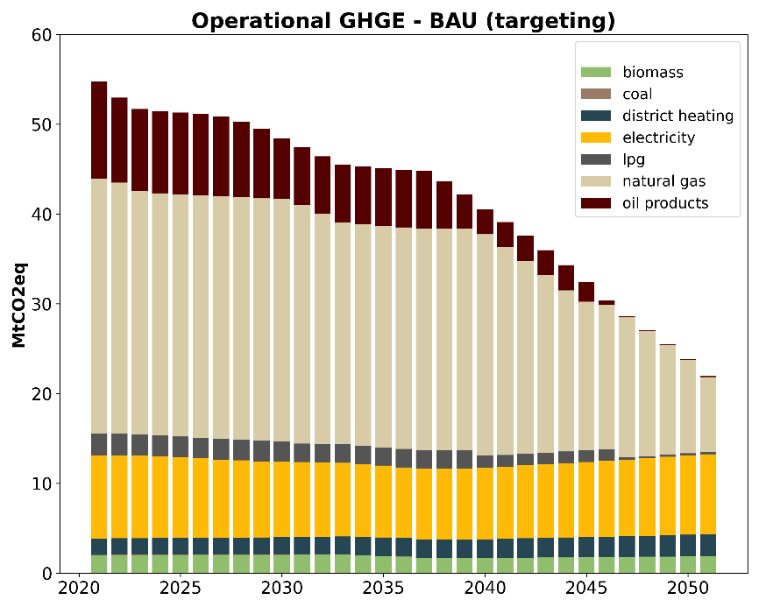
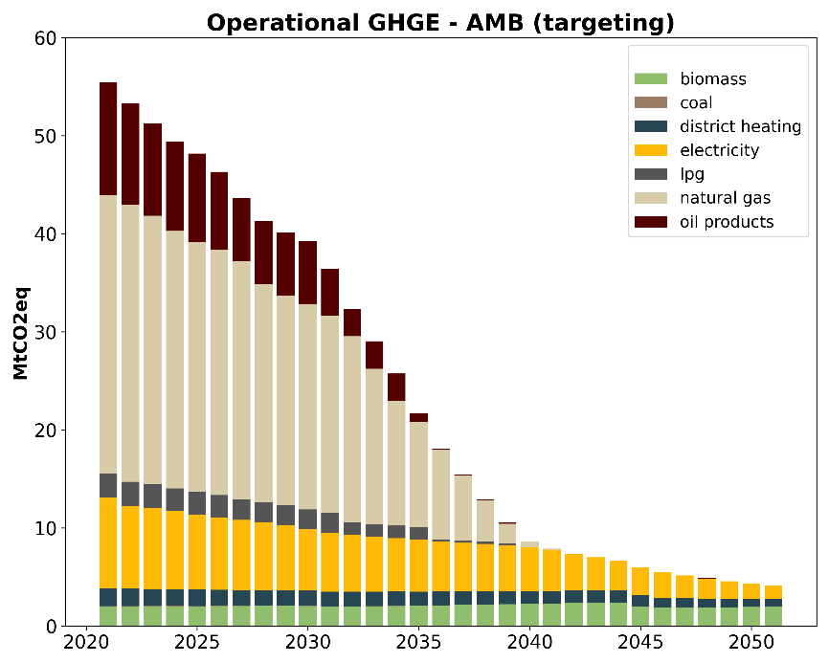

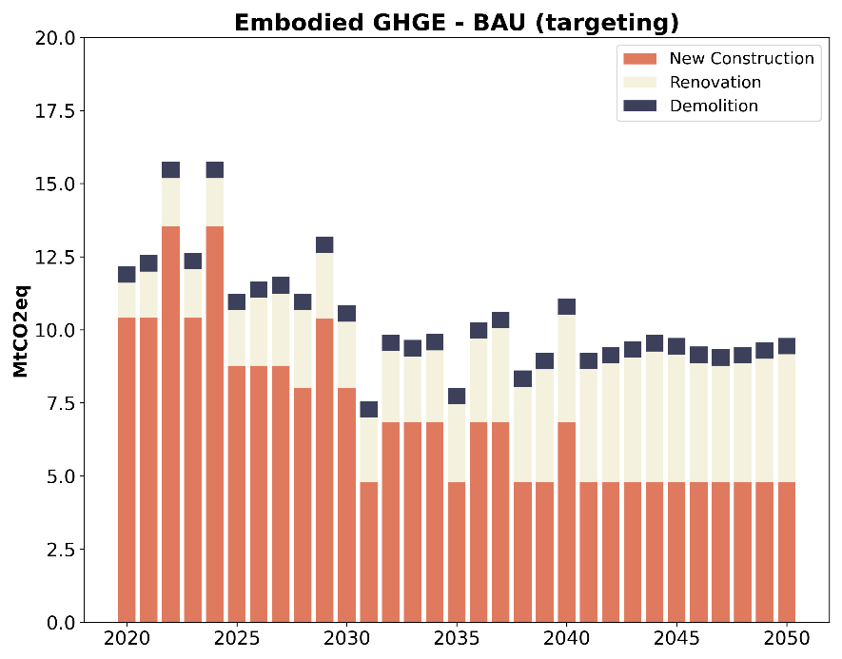
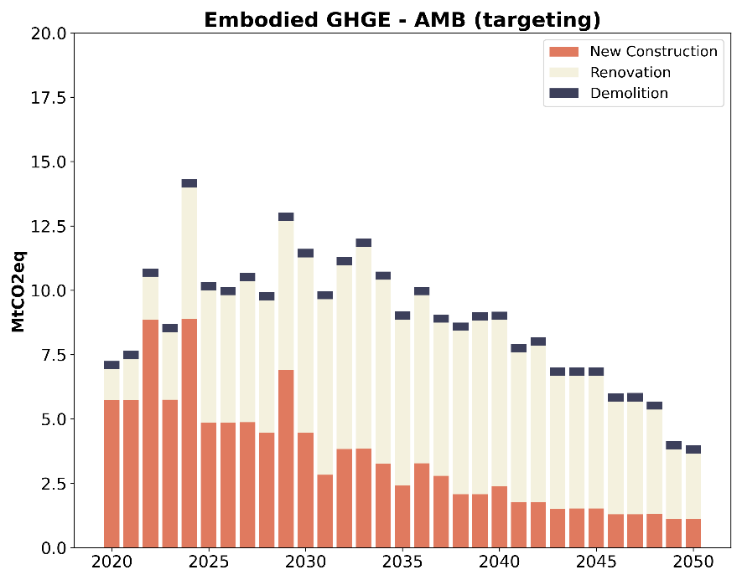
2. Exploratory decarbonisation pathways for residential buildings
Decarbonisation pathways in BAU vs AMB scenarios
RQ2
Methodology
Results
BAU scenario
AMB scenario
60
60
50
50
40
40
Ambitious scenarios require:
Elimination of fossil fuels
Deep decarbonisation of low-carbon energy carriers (SNBC)
Deep decarbonisation of construction materials (e.g. 120-180 kgCO2eq/m² for new construction in 2050)
(RE2020++)
Oil
30
30
MtCO₂eq/yr
MtCO₂eq/yr
Operational GHG
20
Oil
20
20
Fossil fuels
10
10
5
20
20
15
15
Embodied GHG
10
10
MtCO₂eq/yr
MtCO₂eq/yr
5
5
Notes:
But how the different scope of emissions dynamically evolve over the next 3 decades ? Here, we can analyze the operational emissions (above) and the embodied emissions (below) of the two contrasted scenarios.
1) For operational emissions, there is a significant difference in absolute values between the scenarios. In the ambitious scenario, there are no fossil fuels after 2040, and emissions plateau around 5 MtCO2eq in the last decade. The BAU scenario, however, reaches about 20 MtCO2eq by 2050, with a significant share of natural gas still in use, although oil products are phased out by 2045.
2) For embodied emissions, the contrast in absolute terms is less pronounced, even if the ambitious scenario still shows lower values, especially from 2040 onwards. The main difference between the scenarios here is the share of the different stock-level activities in total embodied emissions. In the BAU scenario, new construction consistently accounts for over half of emissions, whereas in the ambitious scenario, emissions from renovations dominate rapidly.
3) Overall, the lessons are that reaching ambitious carbon budgets requires :
The rapid elimination of fossil fuels, which is comparatively the better targeting option in terms of emissions reduction as developed in the manuscript.
The availability and deep decarbonisation of energy carriers that are already relatively low-carbon today such as electricity and district heating
The availability and deep decarbonisation of low-carbon construction materials that enable to reach very ambitious embodied carbon performance levels.

Slide 19
03. Prospective LCA for new construction (RQ3)
Methodology
Building LCA database and prospective LCA
Results
GHG in 2020, 2030, 2040 and 2050 under IMAGE RCP1.9 scenario
Notes:
The last requirement regarding embodied emissions will be the focus of the next section, where we will discuss in detail how we can model the achievement of carbon targets using real buildings from a building LCA database. Indeed, for now, we have only discussed embodied emissions per square meter using the Environmental regulation declining limit values, but we do not know which types of buildings can achieve the targeted performance.

Slide 20









3. Prospective LCA for new construction
Assessing future upstream embodied performance
RQ3
Methodology
Results
National
building LCA
DB
1
3
Typologies
exploration
Decarbonisation
pathways
2
4
Today
benchmark
Future
benchmark
5
Comparison with
target values
from AMB scenario
Notes:
To deal with that issue, we have developed a methodology focused on new construction using the Environmental Regulation database, which contains thousands of building LCAs, although it is currently dominated mostly by individual housing.
First, the methodology involves exploring this database to identify different typologies based on their material composition and geometric attributes using association rule mining and clustering. Due to the growing number of buildings in the database, this approach can provide a better representativeness of newly constructed buildings, can enable to incorporate a wide variety of typologies, and potentially offers more complete information thanks to a complete bill of materials compared to relying on only a few archetypes.
Then, we first compare the current embodied performance of the selected buildings, for the entire buildings and separately for structural work, second work and technical groups. Next, we model how decarbonizing the supply sectors would impact the future performance of buildings and compare these results to the target values identified in the previous chapter. These target values reflect the declining embodied performance outlined in the ambitious scenario presented earlier, which assumes that the declining trends of the Environmental Regulation from 2022 to 2031 will continue until 2050, reaching very low values compared to today’s benchmark.

Slide 21




3. Prospective LCA for new construction
Decarbonisation levers: demand and supply-side
RQ3
Methodology
Results
*
Decarbonisation
of buildings
and building stocks
Demand-side
Supply-side
influence
influence
Sufficiency
Material mix / Design options
Construction materials production
Energy carriers
Influence/interact
“changes in energy supply, production technologies […] that keep demand by end users invariants”**
“modify demand for goods and services”**
* Sacchi et al (2022)
** Creutzig et al (2021)
Notes:
In this work, we focus on modeling the supply-side decarbonization lever using the Premise prospective LCA package. The supply side typically involves changes in energy supply, energy efficiency, the share of different production technologies, or the introduction of new technologies, without modifying end-use demand. Premise facilitates this by allowing modifications to the ecoinvent life-cycle inventory database based on scenarios from Integrated Assessment Models, which have the advantage of covering the entire economy. This enables us to estimate the future impact of different activities available in ecoinvent under various scenarios, such as the emissions resulting from the production of 1kg of cement under the IMAGE Integrated Assessment Model and a 1.5°C scenario.
Since we rely on building LCAs that include Environmental Product Declarations (EPDs), we created a matching system between ecoinvent production activities and the different EPDs, specifically modifying their production phases, namely the A1-A3 phase.
What we do not model in our framework are the demand-side decarbonization levers, which involve modifying the demand for goods and services. When applied to buildings, this can refer to sufficiency measures or changes in design options that promote material efficiency strategies, for example. We have not integrated these, and that constitutes a limitation of our framework in fully understanding the decarbonization potential of buildings.

Slide 22
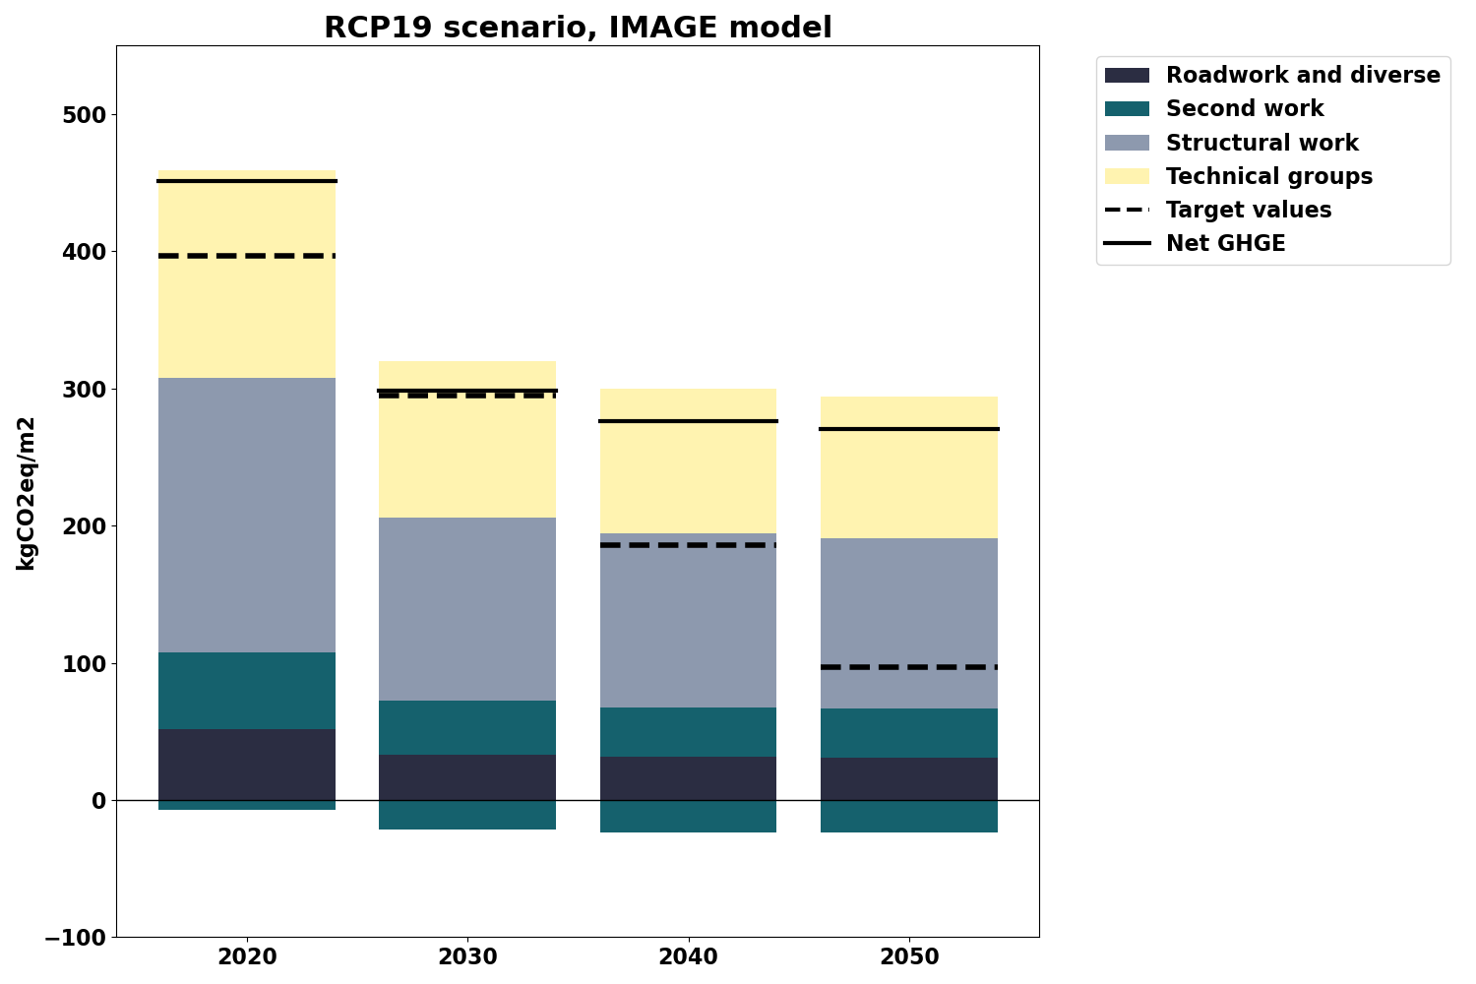
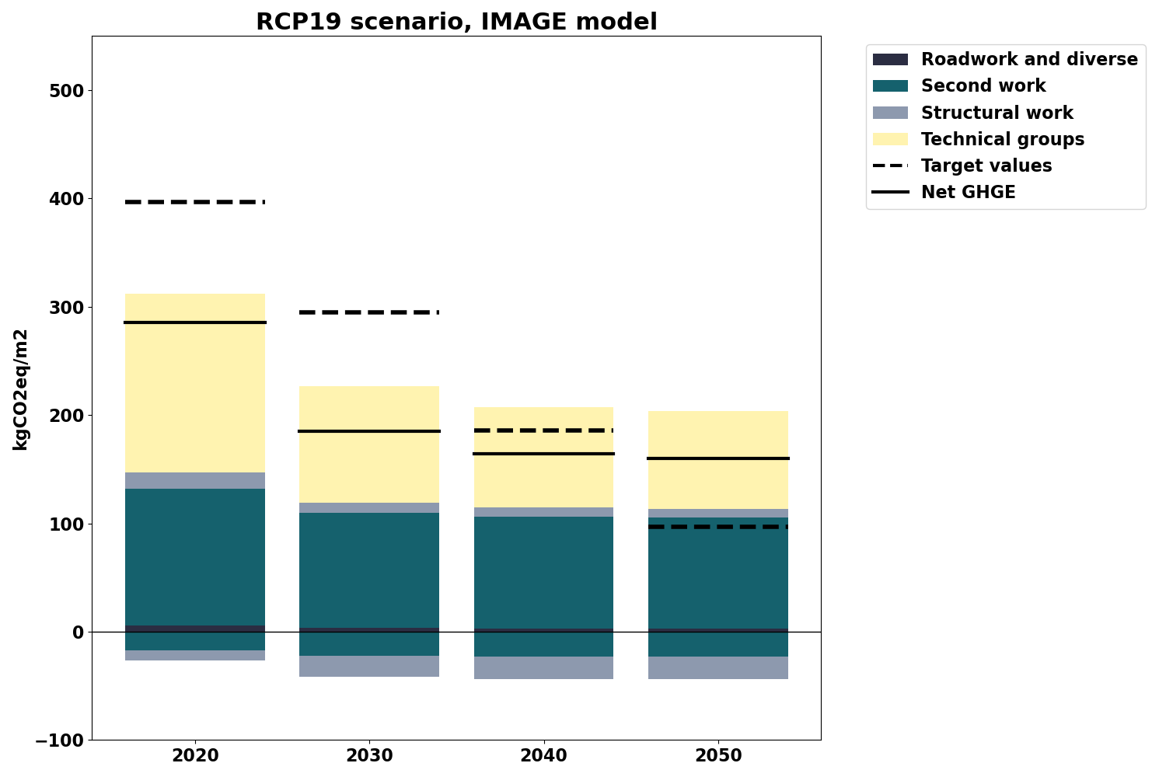
3. Prospective LCA for new construction
Future upstream embodied performance, IMAGE RCP1.9 scenario
RQ3
Methodology
Results
Concrete structure building
Timber structure building
2020
2030
kgCO₂eq/floor area
2040
2050
Notes:
Here we display the results for two buildings that have been chosen based on the typology exploration phase: one with a concrete structure and the other with a timber structure.
We use the IMAGE RCP1.9 scenario, aiming for a 1.5°C temperature increase, which is very ambitious in terms of decarbonization, including in so-called hard-to-abate sectors like cement and steel. This is only a scenario, not a projection of what will happen, and it does not necessarily reflect the technical feasibility described in industrial roadmaps.
In terms of net emissions, represented by the black line, we observe a clear difference between the buildings, where the concrete building uses more emissive materials, especially for the structural work whereas the wood building uses fewer and benefits from carbon storage, accounted for as negative emissions, resulting in lower net emissions.
When comparing the results to the target values per decade from the ambitious scenario, the concrete building clearly underperforms, especially after 2030. In contrast, the wood building meets and even exceeds the target values, except for 2050.
These initial results provide an estimate of the decarbonization potential from supply-side sectors. They indicate that this potential alone is insufficient to meet the target values linked to the ambitious scenario, especially after 2030 and for the buildings that have high market share today.

Slide 23
Conclusion and future outlooks
Conclusion
Discussions, future outlooks
Notes:
This is now time to conclude and outline the key achievements and messages of the thesis, as well as underlining the main outlooks for future research.

Slide 24


Conclusion & future outlooks
Conclusion and future outlooks
RQ1:
Emissions accounting and carbon budgets setting
Building activities ~160MtCO2eq, e.g. 25% of French GHG footprint in 2019
Carbon budgets < 29 MtCO2eq in 2050
A holistic perspective on the French building and construction footprint (SBE2022 Berlin)
Integrating consumption-based targets into sectoral carbon budgets […] (in review)
Land-use change emissions
RQ2:
Exploratory
decarbonisation
pathways
In order to respect the budgets, we need to decarbonize “everything, everywhere, all at once”’
Stock dynamics should embrace high renovation rate and lower construction rate
Fossil fuels eradication is key to efficient decarbonisation
Deep decarbonisation of energy vectors and construction materials is necessary
From limit values to carbon budgets […] (published in Building and Environment)
Decarbonisation roadmap for the building activities […] (CISBAT 2023)
Regionalisation, more sufficiency levers
RQ3:
Prospective
LCA
Supply-side decarbonisation provide an important level, but is insufficient alone
Current market shares are not aligned with carbon budgets
Assessing current and future embodied emissions of new buildings […] (in review)
Availability of LCI, full sector coverage and extending to renovation
Notes:
To answer the research questions, we developed three key blocks:
First, we created a methodology to represent the life-cycle emissions of buildings and define carbon budgets that complement existing climate policies. Applied to France, this methodology showed that building activities emitted 160 MtCO2eq in 2019, and that carbon budgets need to drop at least below 30 Mt. This approach can also be applied to other countries, in particular European ones with similar data availability. A part of this work has been presented at the SBE Conference in Berlin, while another more complete article is currently under review. In terms of outlook, future studies could focus on a bottom-up estimation of land-use change emissions which were not integrated in the thesis.
Second, we developed a framework to link these carbon budgets to the dynamics of the residential building stock and its associated emissions. We integrated existing scenarios and used a building stock database to create different targeting variants. The results indicate that aligning with ambitious carbon budgets requires a combination of higher renovation rates, lower construction rates, rapid elimination of fossil fuels, and deep decarbonization of the energy and industry sectors to supply low-energy carriers and construction materials. These results have been published in Building and Environment, while a more proof-of-concept approach involving a component-based model focused on renovation has been presented in the CISBAT Conference in Lausanne. Here, an important outlooks lies into the regionalisation of the dynamics and the inclusion of more sufficiency levers, alongside the lower square meter per capita already included in the ambitious scenario.
Finally, we investigated how different new building typologies can meet carbon targets at the building level, both now and in the future. Using a building LCA database and prospective LCA tools, we modeled the decarbonization of supply sectors. The results show that even in very ambitious scenarios, achieving the targets is challenging, especially for buildings with high market share today. This highlights the need to model additional measures, such as demand-side measure, and rapidly changing the current market shares to meet climate objectives. This last piece of work is currently under review. Future studies should tackle the problem of life-cycle inventory availability, full sector coverage in prospective LCA tools and the extension of the presented results to renovation packages.

Slide 25

HUGE THANKS to all the people
who contributed to the work presented,
Welcome any QUESTIONS
Notes:
Before concluding this presentation, I would like to thank all the people who helped me, inspired me, gave me feedback, with whom I was able to have discussions and without whom I would not be able to present this work today. A special thanks to Jérémy and all members of the committee. Thank you very much for listening and I now welcome any questions.

Slide 26

State of the art of studied methods
Related studies and databases
Proposed methodology
Proposed methodology
TOP-DOWN
Input-Output Analysis
National emissions accounting
Scenario analysis
ALL BUILDING ACTIVITIES
BOUNDARY
Focus of the presentation
METHODOLOGICAL APPROACH
Life-Cycle Assessment
Building stock modelling
Scenario analysis
RESIDENTIAL ACTIVITIES
Life-Cycle Assessment
Building stock modelling
Scenario analysis
NEW RESIDENTIAL
CONSTRUCTION
BOTTOM-UP
Notes:
We have chosen a methodology that works like an upside-down pyramid, both in terms of approach and boundary.
Indeed, we move from a top-down to a bottom-up analysis and we start by studying all building activities, then focus on residential activities, and finally on new residential construction.
For each step, we use some of the methods mentioned earlier. We begin with input-output analysis and national emission accounting, then use building stock modeling techniques and life-cycle assessment. In each step, we incorporate different scenarios that are integrated into the method in various ways as we will later in the presentation.

Slide 27
Outlooks for future studies
Conclusion
Discussions & outlooks
Extending the scope of emissions accounting
Land-use change emissions
Carbon storage and sequestration
Complexifying stock dynamics
Regionalisation of modelling for new construction demand, renovation and demolition potential
Adding additional sufficiency levers
Continuing the linkage between prospective LCA tools and building LCA database
Urgent need of life-cycle inventories for integration in building LCA database
Similar exercises for renovation needs to be done
Complete coverage of sectors in prospective LCA tools (e.g. heat production)
Further exploring the decarbonisation levers inter-dependencies
Dependencies between decarbonisation levers (Avoid / Improve / Shift)
Potential competition between technologies
Notes:
Turning to future studies, the current blocks can be improved in several ways:
First, the current scope of emission accounting does not include land-use change emissions. These can be added using bottom-up estimation to provide more detailed location-specific data, compared to national inventories. Additionally, we have excluded the quantification of carbon storage and sequestration in buildings, which can also be integrated separately in future methodologies.
Second, the current modeling of stock dynamics was done at the national level. However, certain dynamics might be more relevant if studied at regional or city levels. For example, new construction demand could be differentiated between regions based on socio-economic parameters. Future studies should also integrate other sufficiency levers, such as lower vacancy rates or changes in building usage, alongside the lower square meters per capita already included in the ambitious scenario.
Third, we provided a proof of concept that combines a building LCA database with prospective LCA tools. The main obstacle for a full integration is the availability of life-cycle inventories. Future studies could address this by developing LCI archetypes for main construction materials. Additionally, what has been presented for new construction needs to be extended to renovations. Lastly, a complete coverage of sectors remains to be done in prospective LCA tool, with the heat sector being potentially very important for buildings.
Finally, a common outlook for all blocks is to study the interdependencies of decarbonization levers. This involves exploring how one type of decarbonization lever, such as 'avoid' solutions, can either hinder or accelerate other levers, like 'improve' or 'shift' solutions.

Slide 28
State of the art of studied methods
Related studies and databases
Proposed methodology
Studied methods
Scale
National emissions accounting
Prospective studies
Input-Output Analysis
Life-Cycle Assessment (LCA)
Building Stock
Modelling
Maturity
Standardisation
Hybrid LCA
Notes:
Are produced by different actors (statistical agencies, firms, NGOs, academia)
Have different boundaries/scope for example a rather large one with top-down vision, or a micro one with bottom-up
Have different existing standardisation or guidelines, and thus different levels of maturity
Finally the underlying data are more or less transparent

Slide 29




Climate objectives
Carbon budgets for buildings
Decarbonisation scenarios
Decarbonisation scenarios and roadmaps
GLOBAL
NATIONAL
SECTORAL
MULTI-SECTORAL
Notes:
A vast array of scenarios and modelling exercice is available with different levels of transparency on the data and modelling
Different levels of modelling transparency
Different levels of data availability
IEA more holistic cf equilibrium models

Slide 30
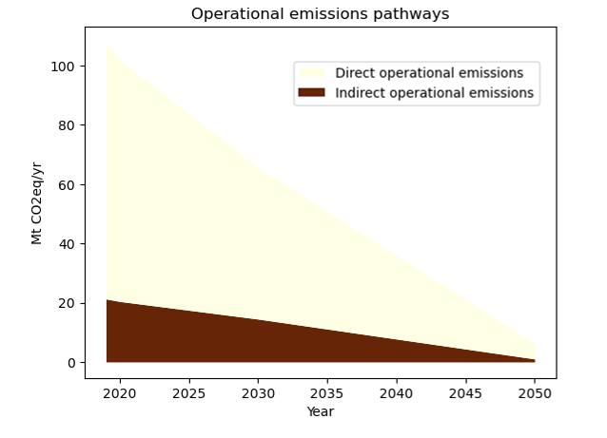


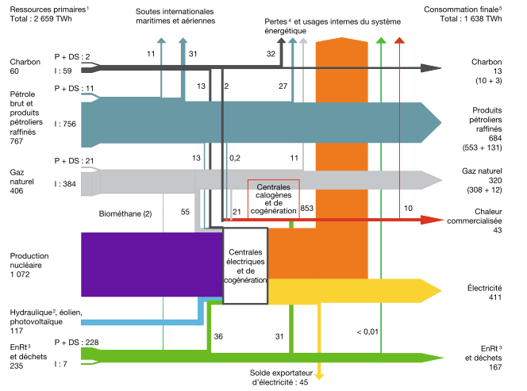


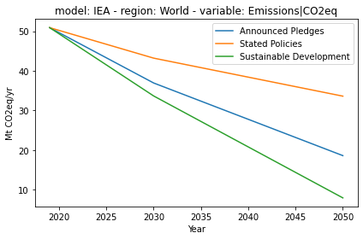


01. Emissions accounting and carbon budgets setting
Emissions accounting and carbon setting methodology
2019
2.1
2050
2.2
GHGE accounting method at national level
Scenarios and decarbonisation pathways
Operational
emissions
National
decarbonation
pathways
Pathways
for
energy
carriers
National
energy
balance
Life-cycle
emissions
factors
F
Gas
x
+
2.1.1
Embodied
emissions
International
decarbonation
pathways
Pathways
by
industries
Multi-regional
input-output
database
National
input-output
statistics
+
2.1.2

Slide 31
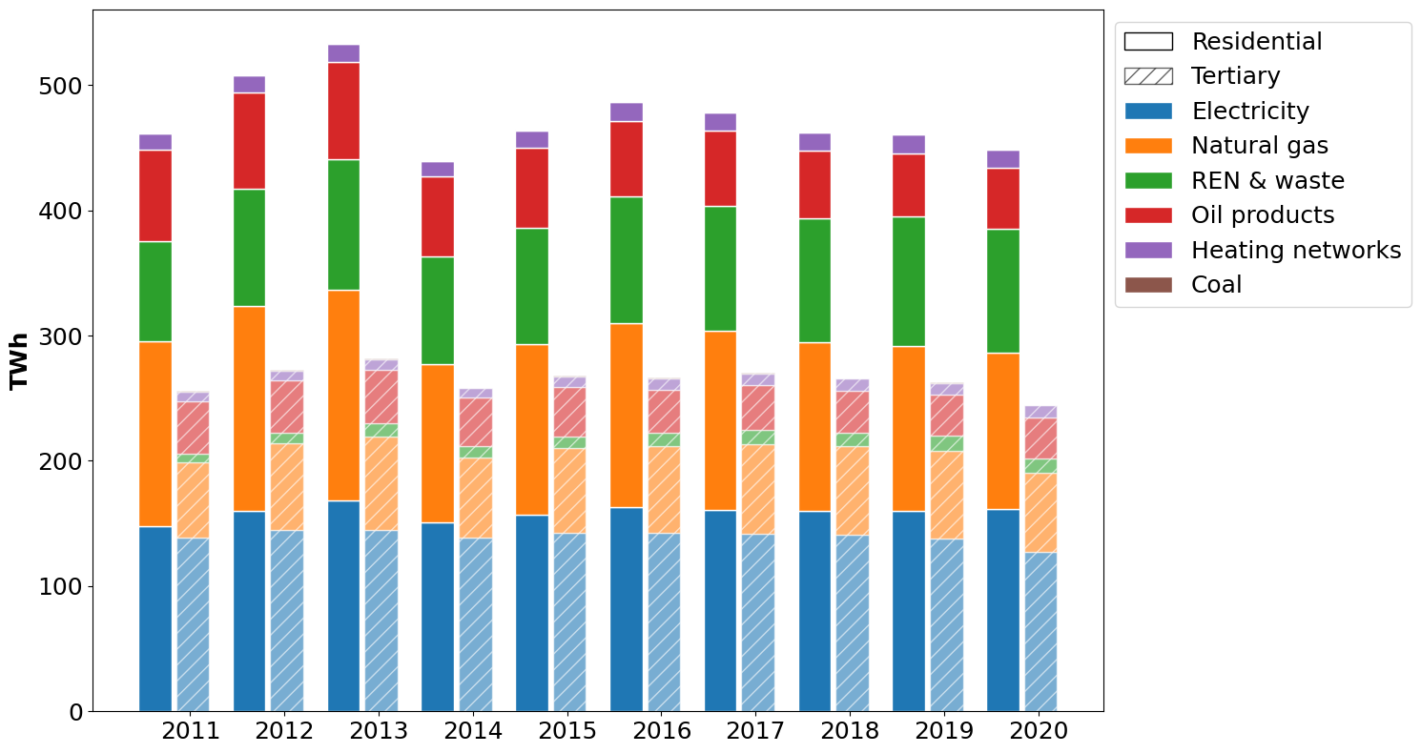
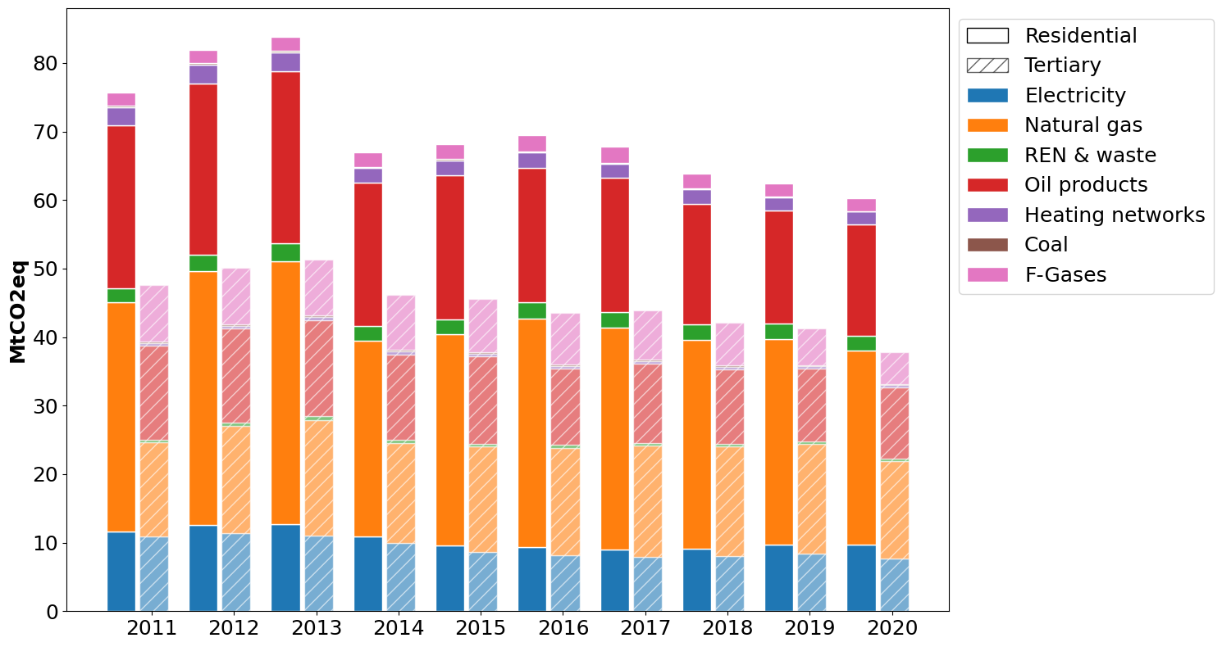
01. Emissions accounting and carbon budgets setting
Energy consumption and operational GHGE in 2019

Slide 32
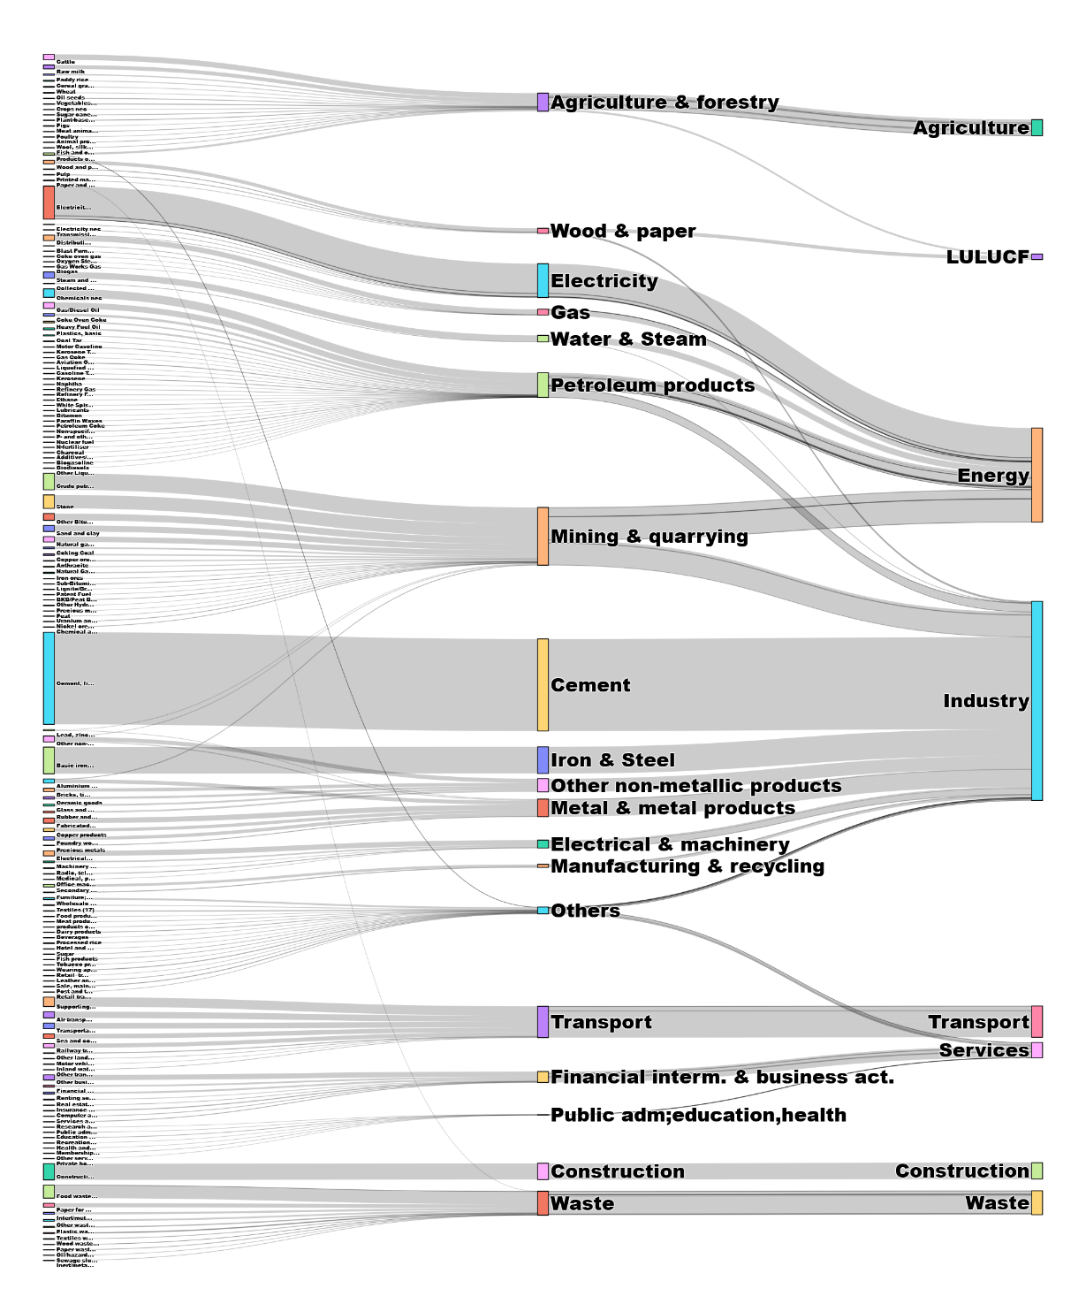
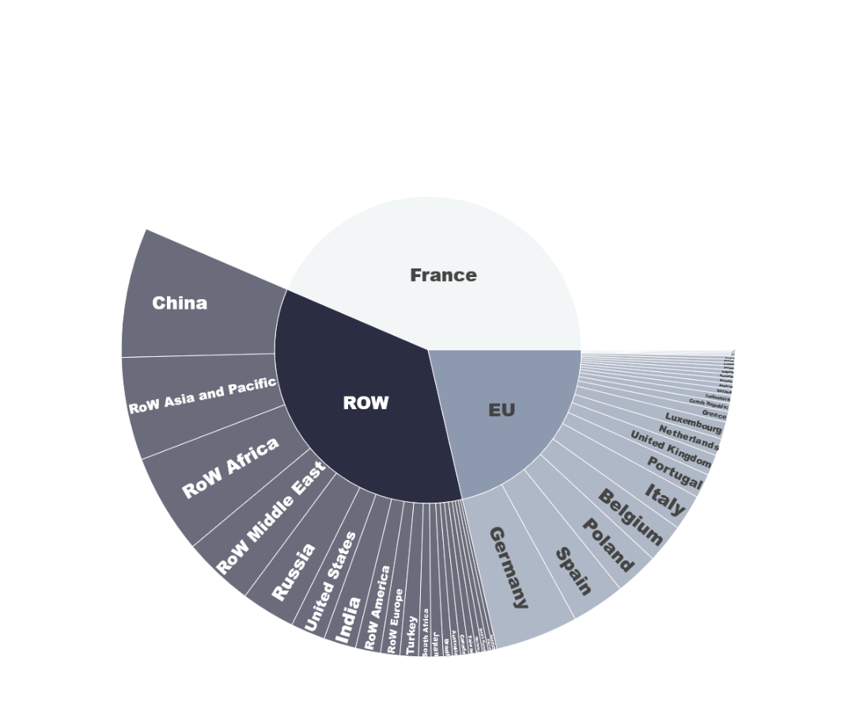
01. Emissions accounting and carbon budgets setting
Embodied GHGE in 2019

Slide 33
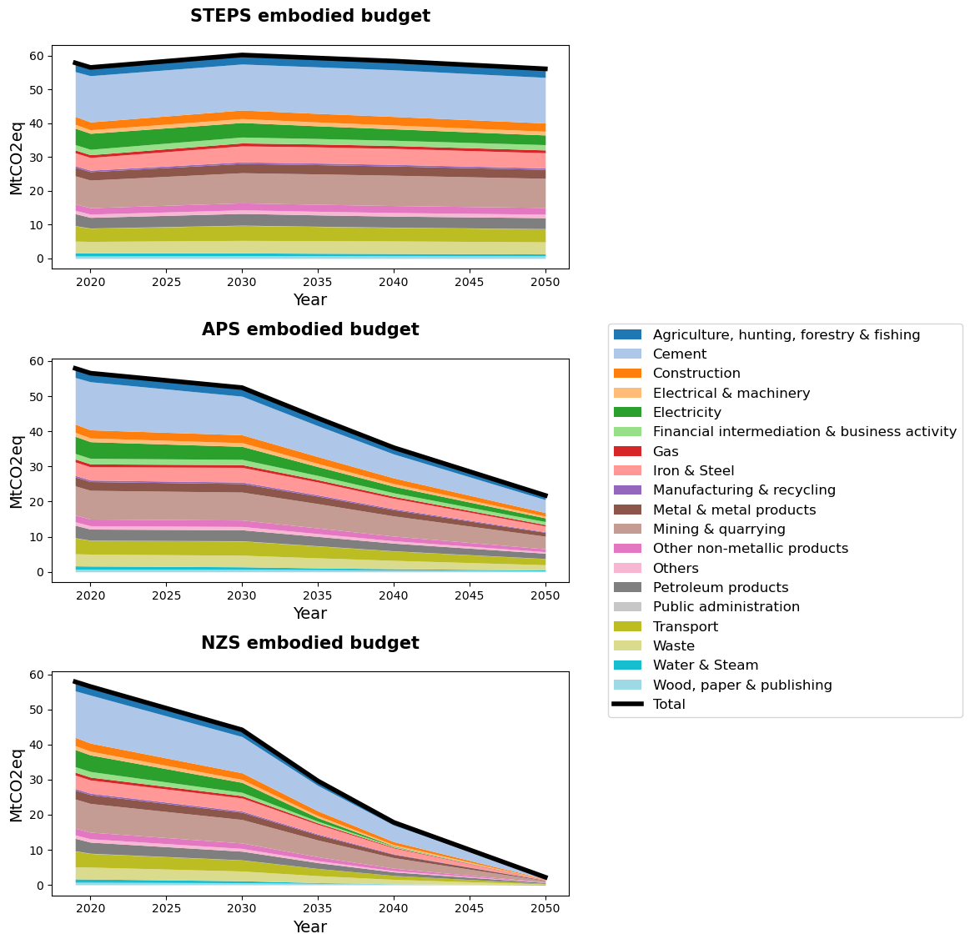
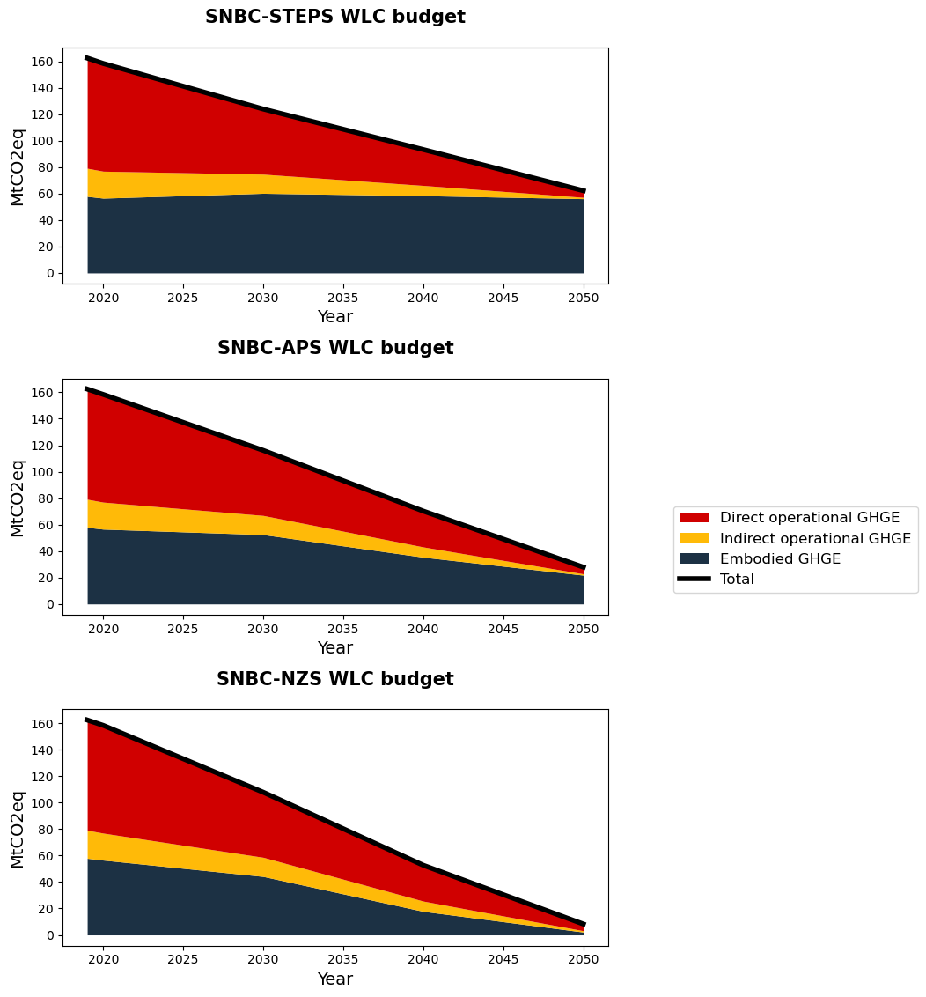
01. Emissions accounting and carbon budgets setting
Embodied and Whole-Life Carbon budgets by 2050

Slide 34
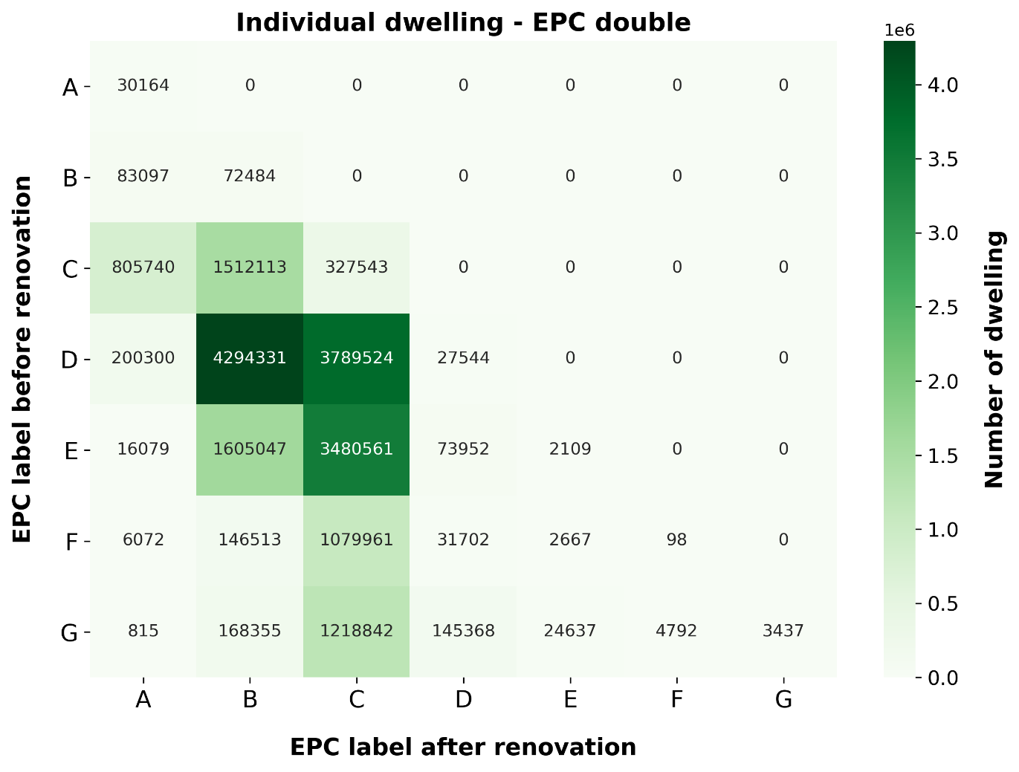
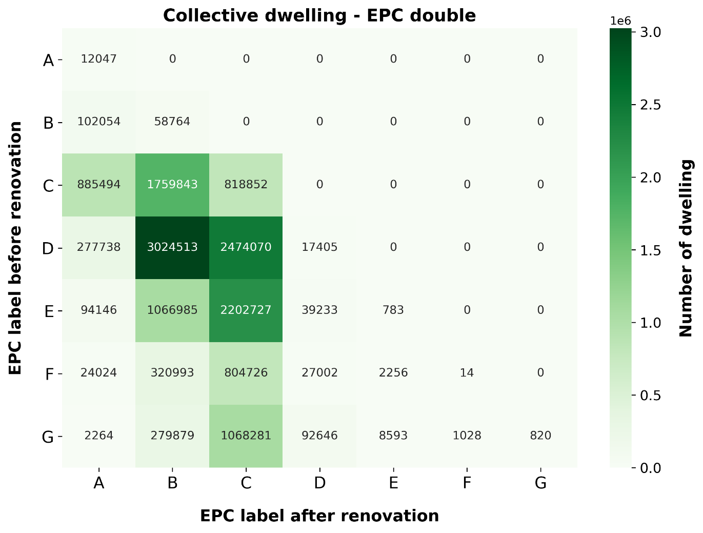
2. Exploratory decarbonisation pathways for residential buildings
EPC label matrix – Energy simulation results
RQ2
Methodology
Results
Notes:
Looking at emissions in 2050, we see a significant gap between the scenarios. When compared to the 2050 budgets, we see that the ambitious scenario is almost aligned with the SNBC-Net Zero budget, although the budget is defined for the entire building activities, and not just the residential activities. Therefore, this scenario lies between the Net Zero and the Announced Pledges scenario. In contrast, the BAU scenario exceed the SNBC-Announced Pledges scenario, therefore not reaching the 2°C objective of the Paris Agreement.
Looking at the share of the different scopes of emissions, we see two interesting observations:
First, the more ambitious the scenario, the greater the share of embodied emissions.
Second, in both scenarios, we see an increasing share of indirect operational emissions
Because the remaining carbon budgets are about what is left to emit, cumulative emissions are also very important to look at. When we compare the scenarios from that metric, we also see a significant different, although it is less pronounced than for the 2050 emissions. So here, we see the relevance of starting to decarbonize the sooner possible to decrease the cumulative emissions.

Slide 35
2. Exploratory decarbonisation pathways for residential buildings
EPC label matrix – Renovation and demolition procedure
EPC label after renovation
 | A | B | C | D | E | F | G
A
B
C
D
E
F
G
7
6
Demolition
5
EPC label before renovation
4
Renovation
3
x
Modelling direction
2
1

Slide 36
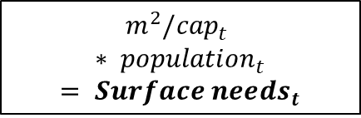
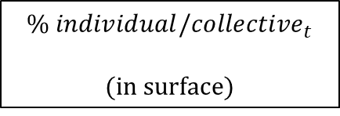
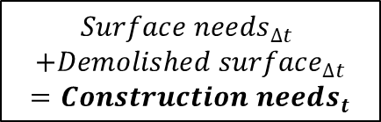
2. Exploratory decarbonisation pathways for residential buildings
Construction dynamics
For t in range (2020, 2050, 1)
$${m^{2}/cap}_{t}$$
$$∗ {population}_{t}$$
$$= {Surface needs}_{t}$$
What is needed to satisfy population needs?
$${Surface needs}_{∆t}$$
$$+{Demolished surface}_{∆t}$$
$$={Construction needs}_{t}$$
Based on demolition and (potential) additional needs, how much should we build?
$${\% individual/collective}_{t}$$
(in surface)
How do we share this new surface between
individual/collective surface?
On average, what is the surface of one
individual/collective dwelling?
m²/dwelling type

Slide 37
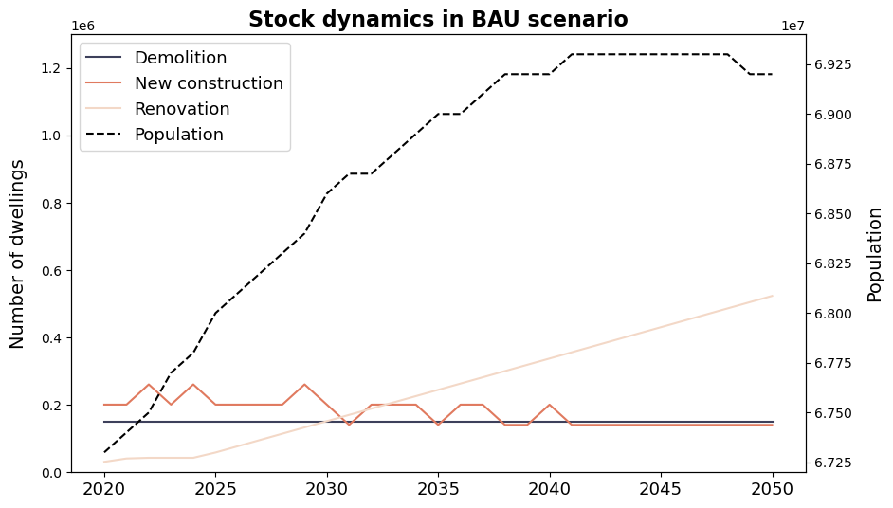
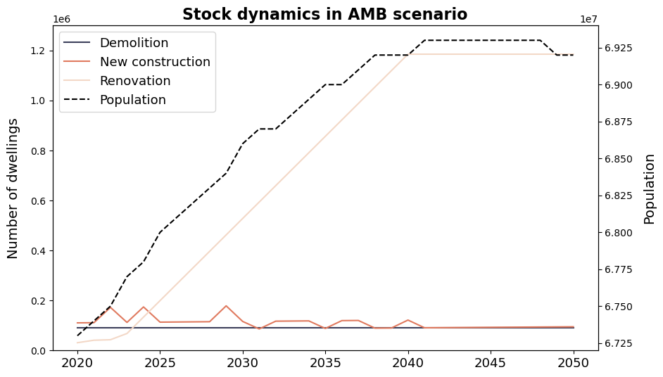
2. Exploratory decarbonisation pathways for residential buildings
Stock dynamics
RQ2
Methodology
Results
Notes:
Looking at emissions in 2050, we see a significant gap between the scenarios. When compared to the 2050 budgets, we see that the ambitious scenario is almost aligned with the SNBC-Net Zero budget, although the budget is defined for the entire building activities, and not just the residential activities. Therefore, this scenario lies between the Net Zero and the Announced Pledges scenario. In contrast, the BAU scenario exceed the SNBC-Announced Pledges scenario, therefore not reaching the 2°C objective of the Paris Agreement.
Looking at the share of the different scopes of emissions, we see two interesting observations:
First, the more ambitious the scenario, the greater the share of embodied emissions.
Second, in both scenarios, we see an increasing share of indirect operational emissions
Because the remaining carbon budgets are about what is left to emit, cumulative emissions are also very important to look at. When we compare the scenarios from that metric, we also see a significant different, although it is less pronounced than for the 2050 emissions. So here, we see the relevance of starting to decarbonize the sooner possible to decrease the cumulative emissions.

Slide 38
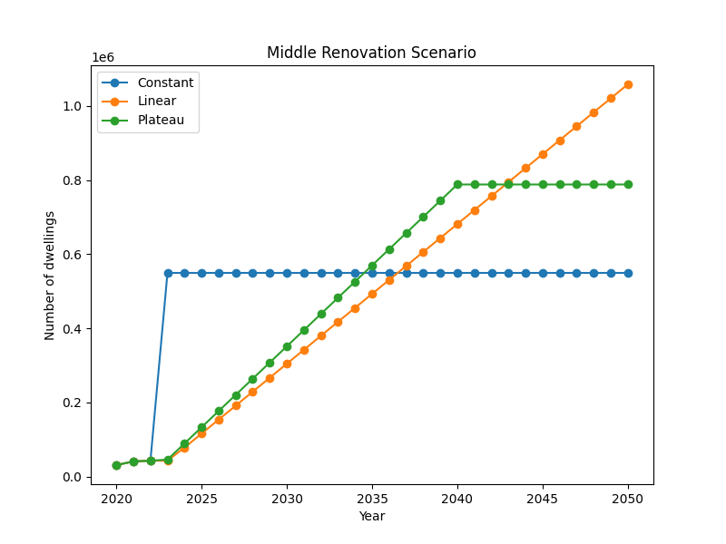
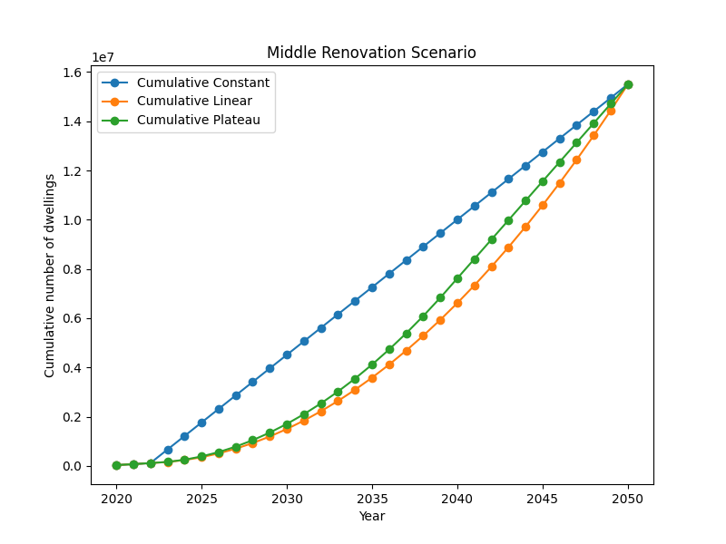
2. Exploratory decarbonisation pathways for residential buildings
Renovation paces
RQ2
Methodology
Results

Slide 39
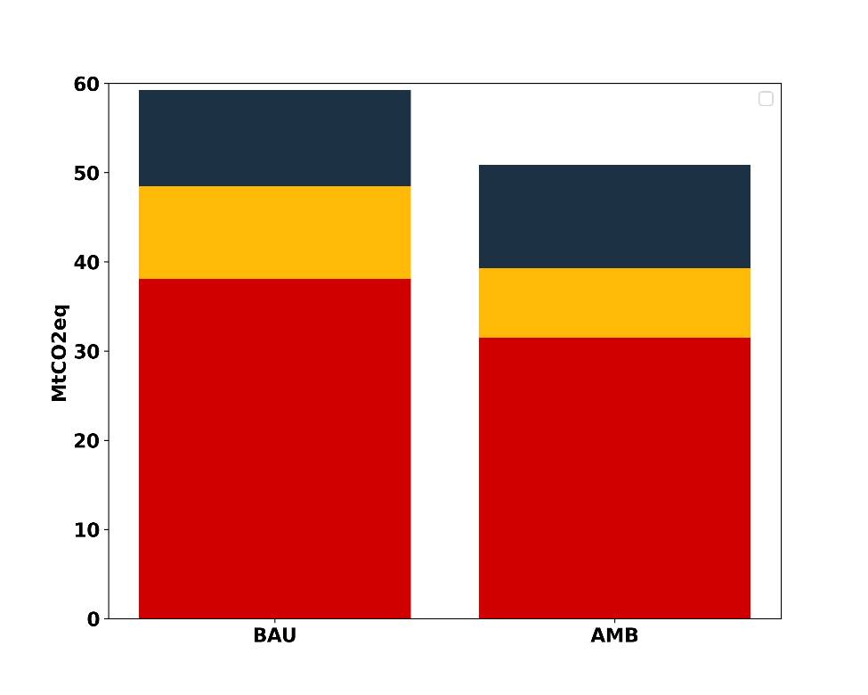
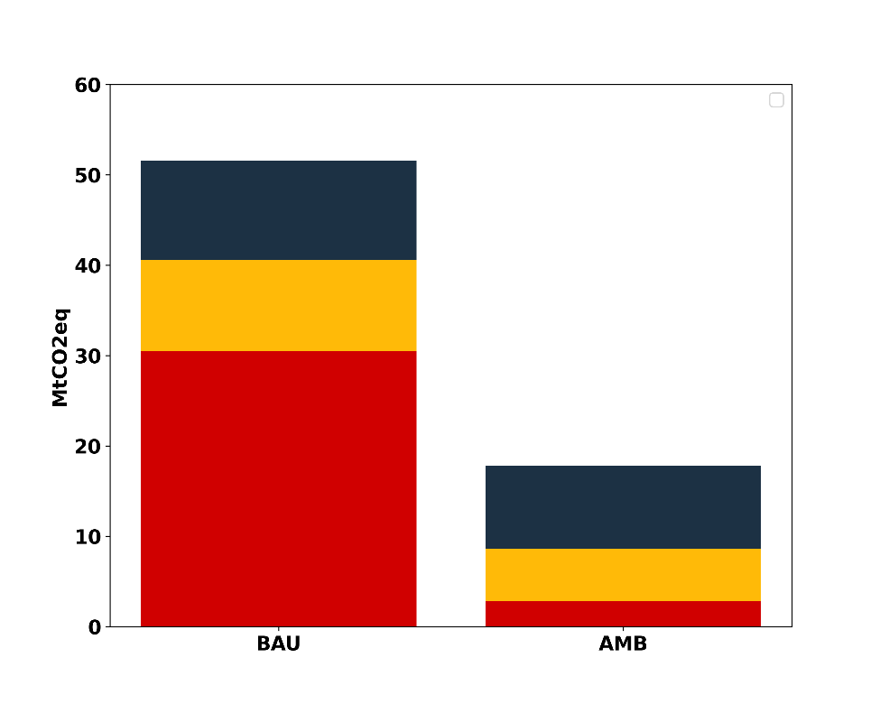
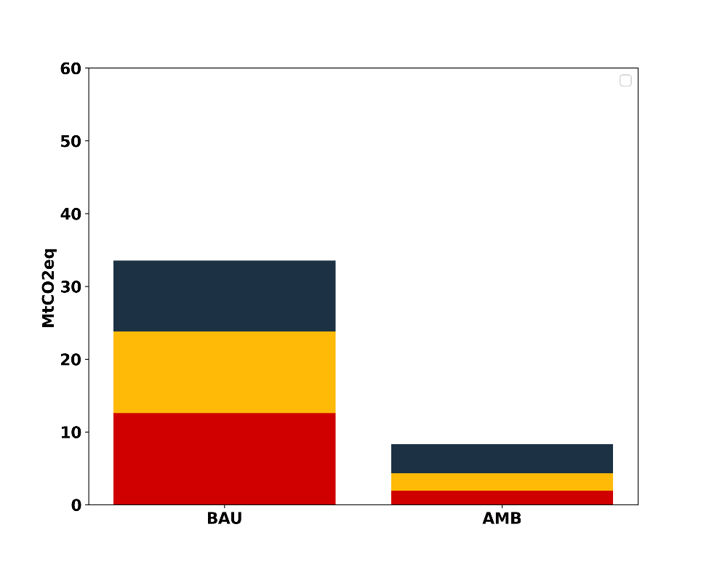
2. Exploratory decarbonisation pathways for residential buildings
2030, 2040 and 2050 GHG in BAU and AMB
RQ2
Methodology
Results
2030 GHG
2040 GHG
2050 GHG
BAU scenario
AMB scenario
BAU scenario
AMB scenario
BAU scenario
AMB scenario
Notes:
Looking at emissions in 2050, we see a significant gap between the scenarios. When compared to the 2050 budgets, we see that the ambitious scenario is almost aligned with the SNBC-Net Zero budget, although the budget is defined for the entire building activities, and not just the residential activities. Therefore, this scenario lies between the Net Zero and the Announced Pledges scenario. In contrast, the BAU scenario exceed the SNBC-Announced Pledges scenario, therefore not reaching the 2°C objective of the Paris Agreement.
Looking at the share of the different scopes of emissions, we see two interesting observations:
First, the more ambitious the scenario, the greater the share of embodied emissions.
Second, in both scenarios, we see an increasing share of indirect operational emissions
Because the remaining carbon budgets are about what is left to emit, cumulative emissions are also very important to look at. When we compare the scenarios from that metric, we also see a significant different, although it is less pronounced than for the 2050 emissions. So here, we see the relevance of starting to decarbonize the sooner possible to decrease the cumulative emissions.

Slide 40
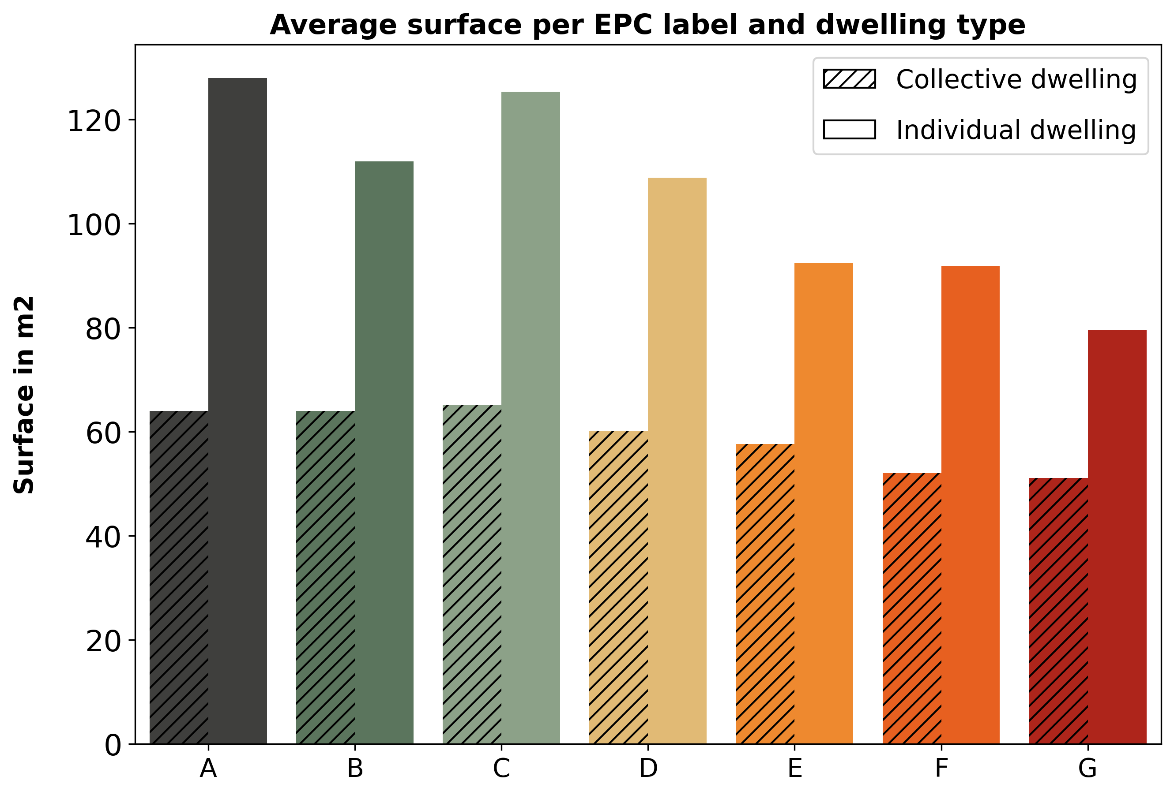
2. Exploratory decarbonisation pathways for residential buildings
Average surface per EPC label and dwelling type
RQ2
Methodology
Results

Slide 41
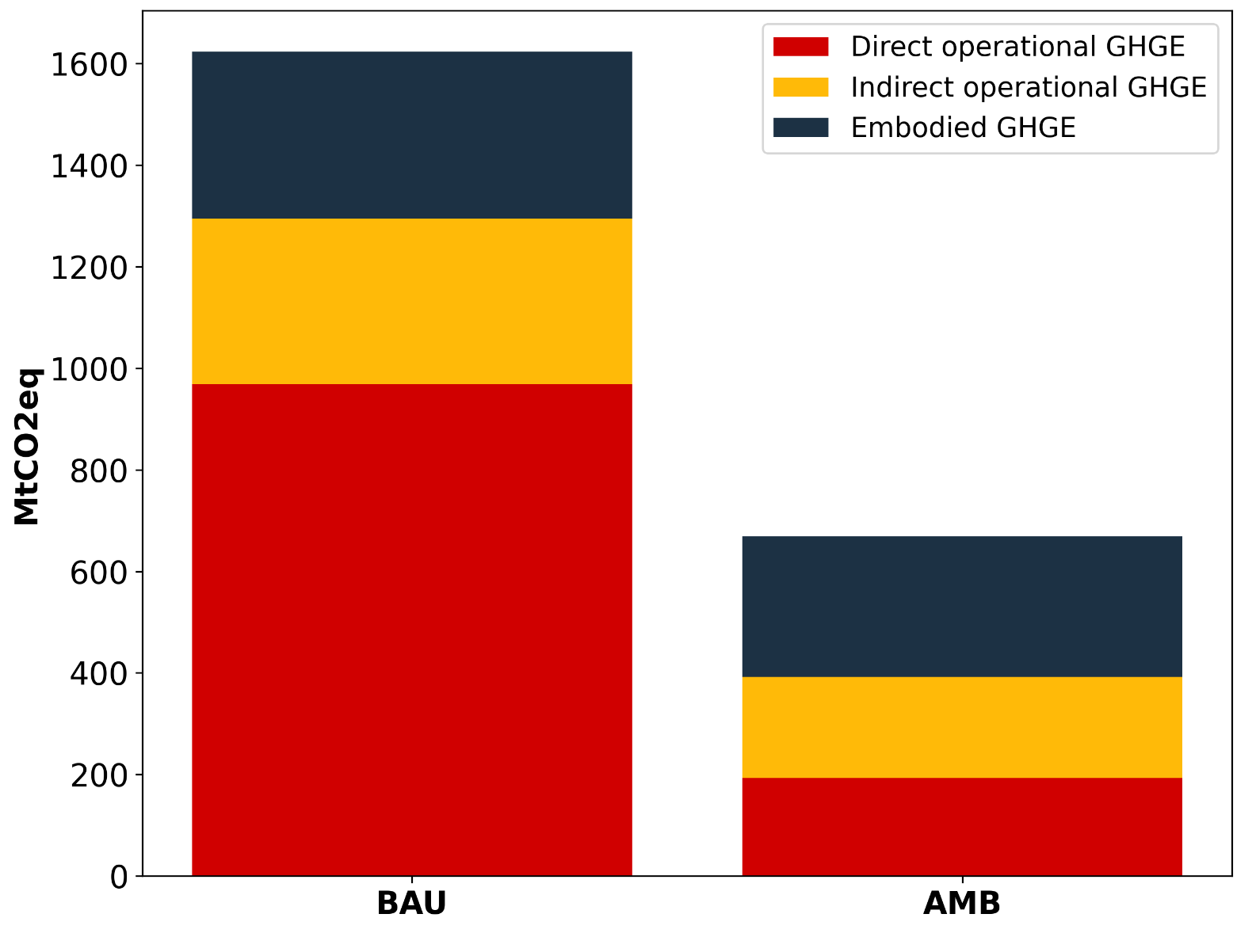
Carbon budgets
Methodology
Results
2. Exploratory decarbonisation pathways for residential buildings
Cumulative 2020-2050 GHG in BAU vs AMB scenarios
The sooner the reduction, the better
Non-linear budgets need to be developed
BAU scenario
AMB scenario
Notes:
Because the remaining carbon budgets are about what is left to emit, cumulative emissions are also very important to look at. When we compare the scenarios from that metric, we also see a significant difference, although it is less pronounced than for the 2050 emissions. So here, we see the relevance of starting to decarbonize the sooner possible in order to avoid the important emissions of the first years.

Slide 42
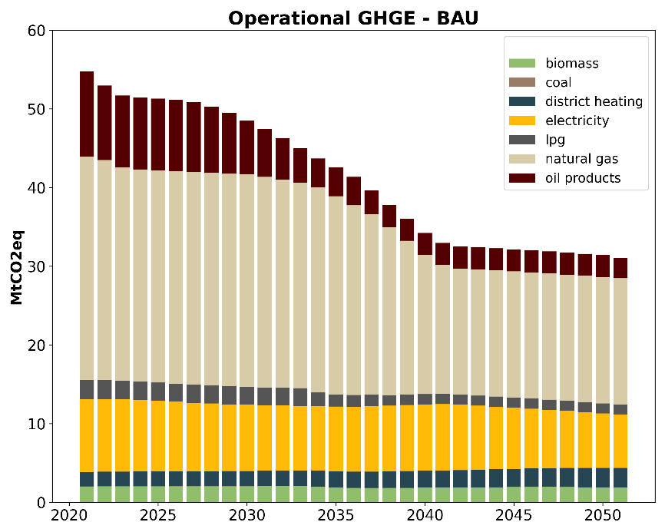
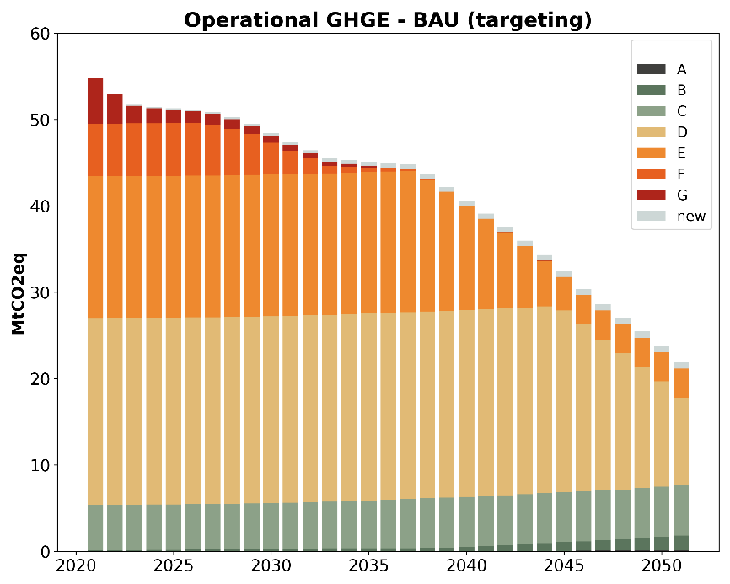
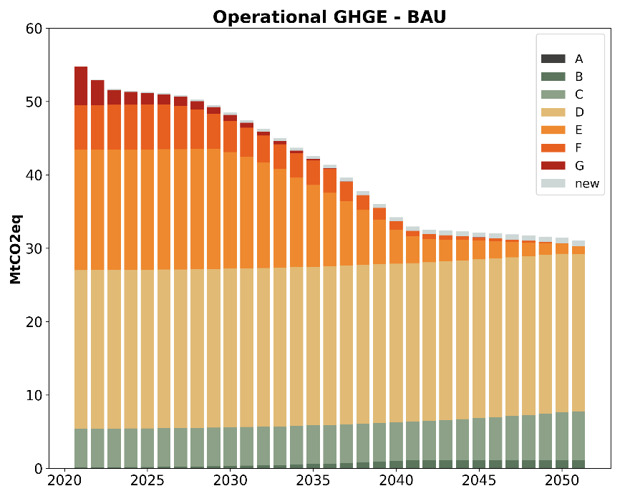
Carbon budgets
Methodology
Results
2. Exploratory decarbonisation pathways for residential buildings
Results – Targeting variants, example in BAU
Fossil fuels targeting
EPC targeting
Energy carriers
Plateau from 2040 due to renovation of relatively poor energy efficiency housing (e.g., D-E) that already uses low-energy carriers
Energy performance label
Notes:
The operational emissions results presented before showed the fossil fuel targeting variant. Here, taking the case of the BAU scenario, we compare it with the energy performance targeting variant.
As we can see, in the last decade, there is a significant difference: the first targeting option shows a steep decrease, while the second shows a plateau.
This difference arises because, in the second targeting option, we target dwellings with medium to low energy performance that already use low-carbon energy vectors. Therefore, the emissions reduction is less advantageous compared to changing from fossil fuels to low-carbon energy vectors like electricity, biomass, or district heating.

Slide 43
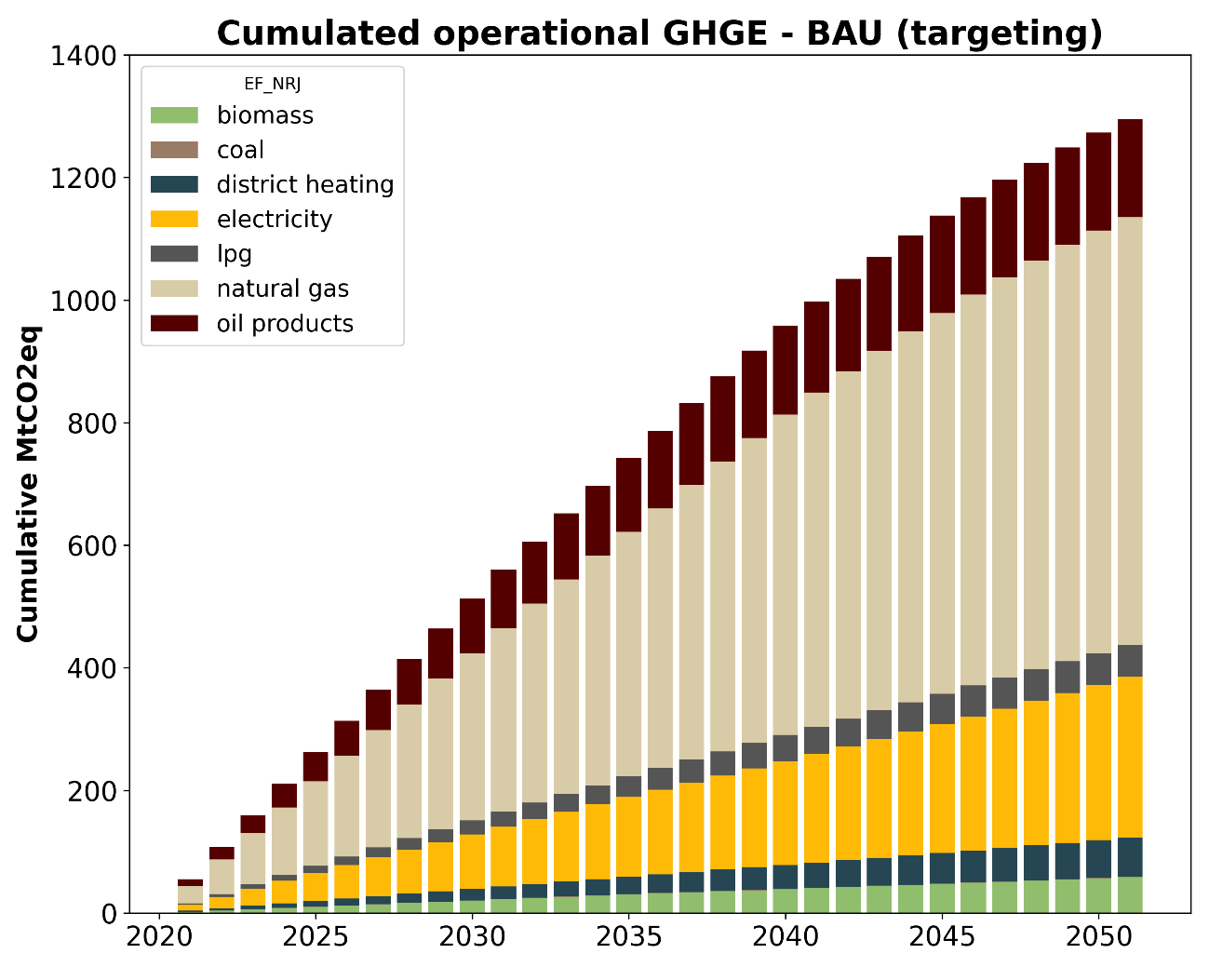
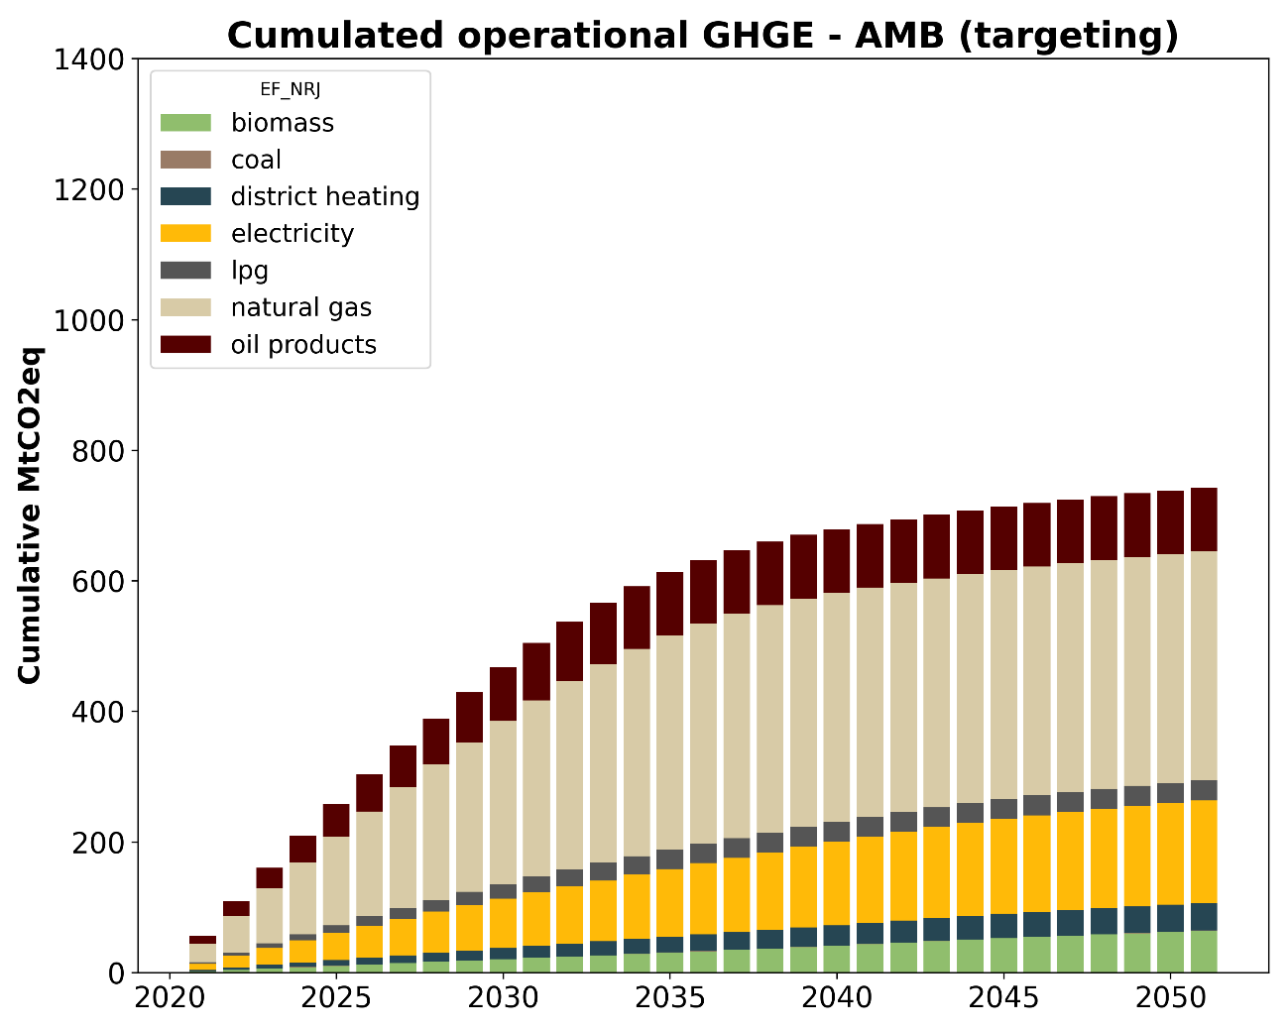
Carbon budgets
Methodology
Results
2. Exploratory decarbonisation pathways for residential buildings
Results – Cumulative GHG between scenarios

Slide 44
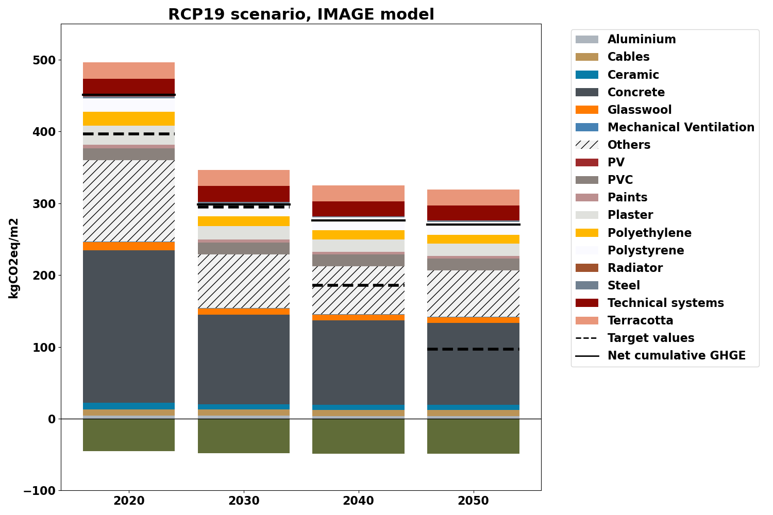
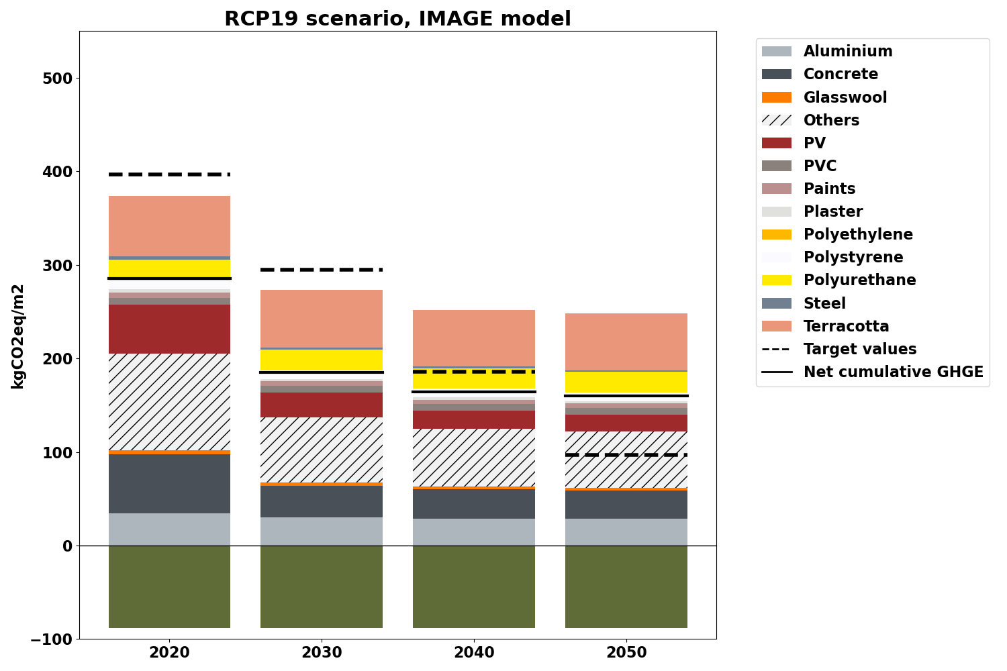
3. Prospective LCA for new construction
Future upstream embodied performance, IMAGE RCP1.9 scenario
RQ3
Methodology
Results
Concrete structure building
Timber structure building

Slide 45
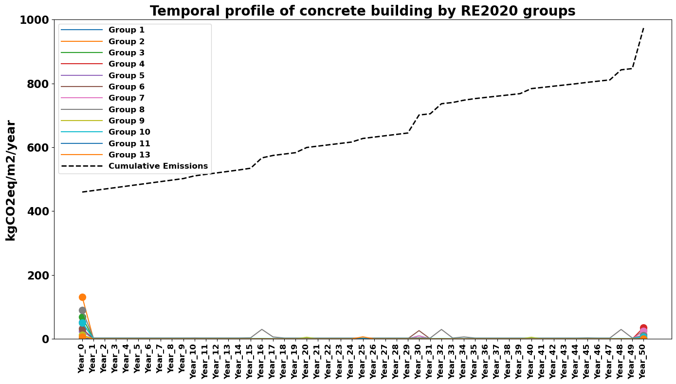
3. Prospective LCA for new construction
Temporal profile
RQ3
Methodology
Results

Slide 46
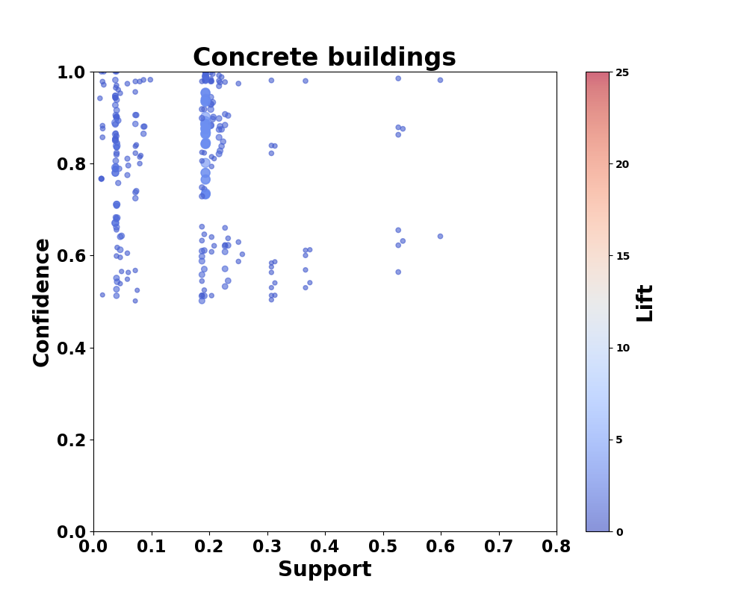
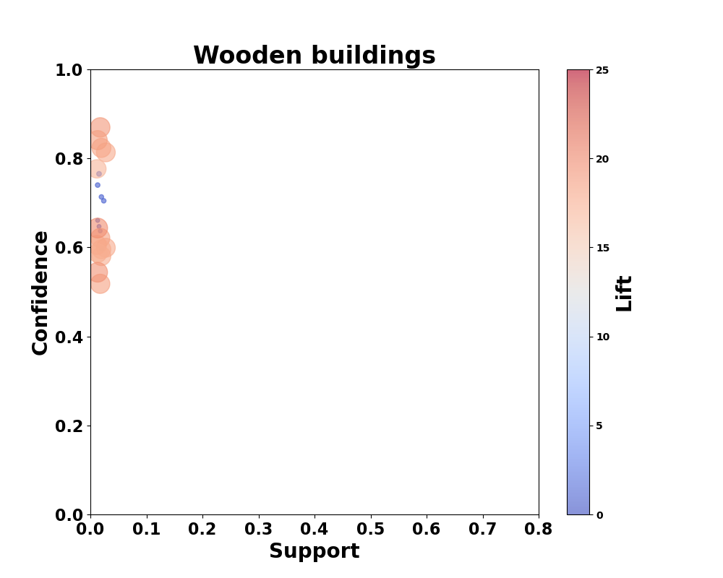
3. Prospective LCA for new construction
Clustering
RQ3
Methodology
Results
Variables:
Main structure
Roofs
Floors
Foundations
Confidence(X ⇒ Y ) = Support(X ∪ Y ) / Support(X)
Lift(X ⇒ Y ) = Confidence(X ⇒ Y ) / Support(Y )
Notes:
This technique generates rules that depict the likelihood of associations between variables, facilitating the identification of recurring construction archetype patterns within the database. Key metrics in association rule mining include support, confidence, and lift.
-The support of an itemset X measures the frequency of variable association within the dataset
-Later, the confidence measures the probability of seeing the consequent given the antecedent
-Finally, the lift evaluates how much more frequently the antecedent and consequent co-occur than would be expected under statistical independence

Slide 47











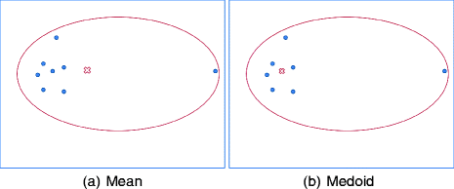
Sampling and clustering procedure
2
1
Stratification
Categorical var
Building stock DB
POPULATION
SUB-POPULATION
3
Clustering
Numerical var
4
MEDOID

Slide 48


3. Prospective LCA for new construction
Clustering
RQ3
Methodology
Results
Notes:
surface area, height, and specific areas for the building’s bay, wall and floor.

